Slide 1
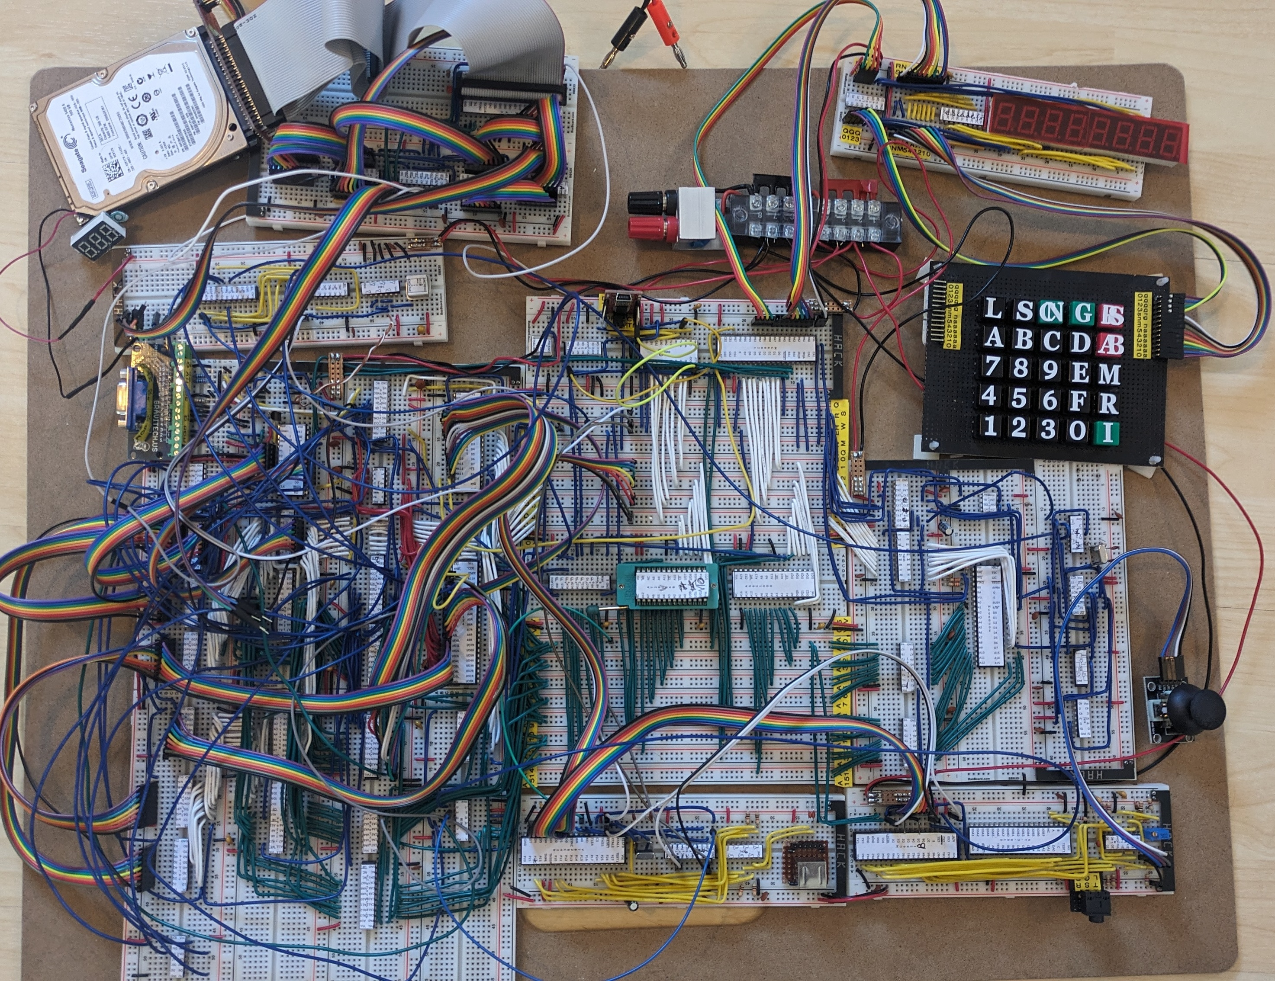
IDE Hard disk & Controller
LED 7 Segment Display &
Keypad
Power
Distribution
VGA Video Controller
80 x 30 16 Colour
640 x 480 2 Colour
320 x 200 256 Colour
MCGA mode compatible
Serial & PIA
CPU, Clock & Buffers
ROM, RAM, Address Decoder
PS2 Keyboard
Sound & Joystick

Slide 2

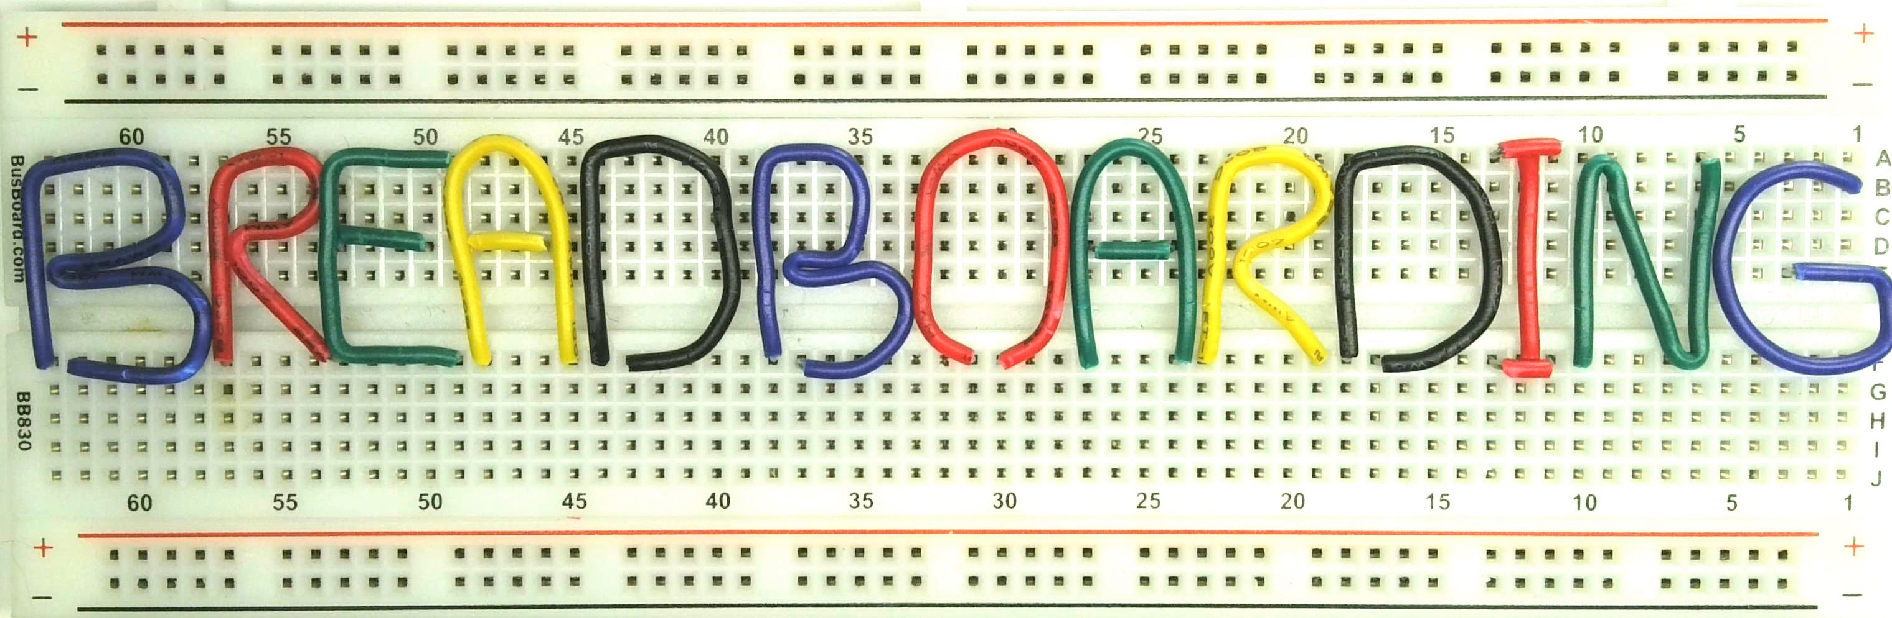
BREADBOARD PC 8088 INTRODUCTION PC#1

Slide 3
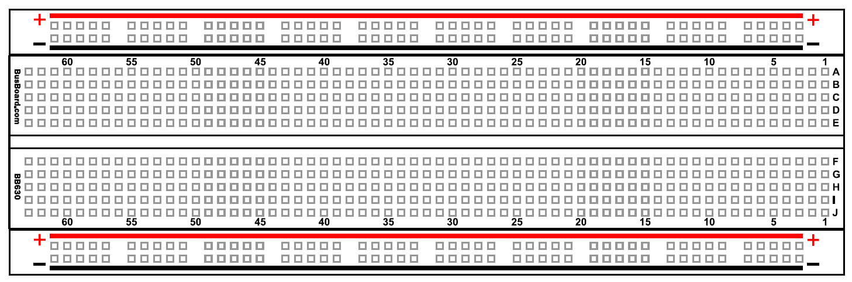
WHY Use breadboards?
Breadboarding Labs Channel
Started August 2022
Build reliable digital electronics projects
Using good quality breadboards
At frequencies of 25MHz and beyond

Slide 4
WHY Use breadboards?
Electronics engineers advise against use of Breadboards
I am an electronics hobbyist, inspired by Ben Eater on YouTube
Allows a design to evolve step by step as understanding grows
Printed Circuit Boards (PCBs) take longer and don’t allow the same flexibility or project evolution
Breadboards allow projects to be re-used and recycled

Slide 5
BREADBOARD DISADVANTAGES
Projects can be unreliable with poor quality breadboards
Need DIP Chips or adapters for non DIP chip layouts (PLCC, LGA, TQFP)
Power distribution problems
Computer Buses cumbersome using 2 wide power strips for bus rails
Hand cut wiring can be time consuming but gives neater layouts
Use BusBoard Prototype Systems (or similar)
Retro 1980’s projects not an issue
Follow Breadboarding Tips for power distribution and volt metering
Use Stripboard bus with 0.1” connectors and Dupont ribbon cables
Dupont ribbon cables with 8 pin shells

Slide 6
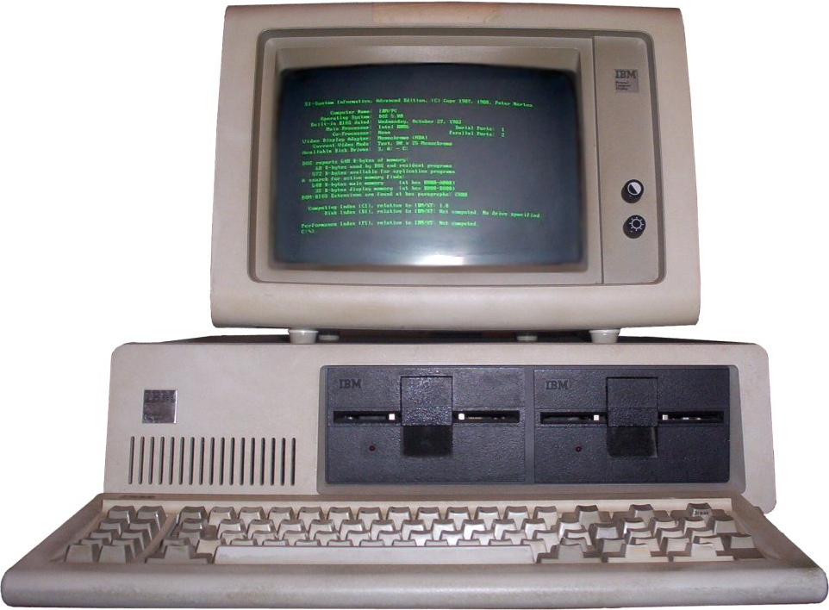
IBM PERSONAL COMPUTER (PC)
The IBM Personal Computer (PC) was released in October1981
Used the Intel 8088 version of the 8086 processor
8 bit data bus vs 16 bit for 8086
A number of 8086/8088 breadboard projects out there
Building and programming a 16bit Intel x86 Breadboard Computer
I am not aware of any PC compatible 8088 Breadboard project (PCB Only)

Slide 7
Breadboard PC - Intel 8088 PC-XT Hybrid
OS
Run an early version of MS-DOS (3.3x) or PC-DOS (2.11)
Video
Monochrome Display Adaptor (MDA) compatible
1981 PC and PC-XT
Clock, CPU and bus control, 8-bit ISA Bus
Direct Memory Access (DMA) controller and Timer
8255 Port and Speaker
PC-AT
Real time clock
Dual Interrupt Controllers (IRQ0-15, PC/XT IRQ0-7) Mouse/Network Card
IBM PS/2
PS/2 Keyboard, Mouse and 8042 Controller,
3.5” 1.44MB Floppy Disk Drive & controller
MCGA Display Adaptor (CGA + 640x480 2 colour, 320x200 256 colour)
Compaq Deskpro 386
IDE Disk and Controller
80 x 25 with 8x16 Character ROM for VGA output

Slide 8
WHY BOTHER WITH A BREADBOARD PC?
Nanocomp 6809 Project now complete
Project started in 1981on PCBs and wiring pen
Re-started in 2020 now on 18 breadboards (& 18 power bus rails)
VGA compatible video and graphics runs Tetris, Lunar Lander and displays 256 Colour PNG Images
Learnt a massive amount, especially about computer video generation
I’ve been using PCs since 1987 but not much ‘under the hood’
Aim to understand all hardware, BIOS and MS-DOS internals
No one else appears to have done it
Experts advise against large/complex breadboard projects – but wire wrap OK

Slide 9
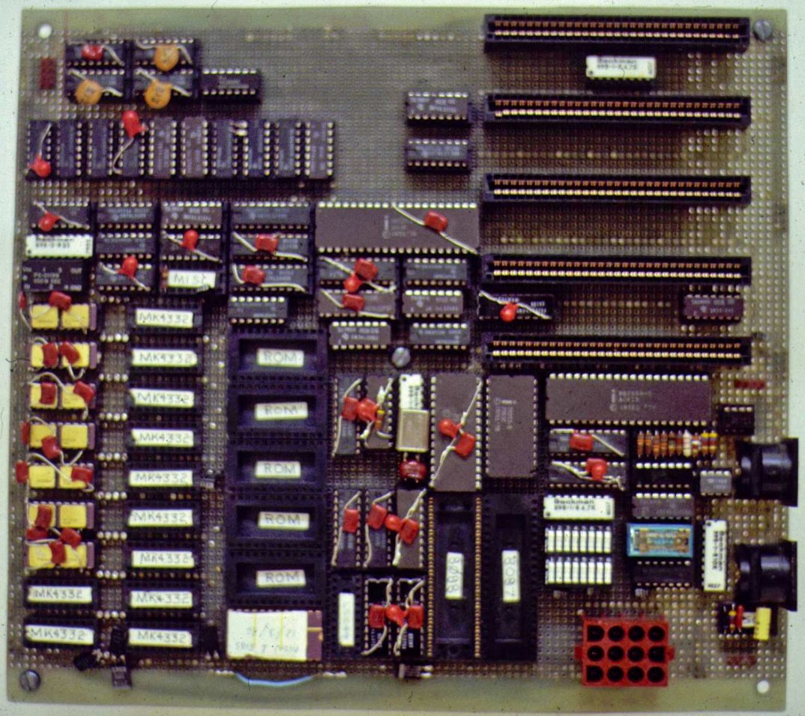
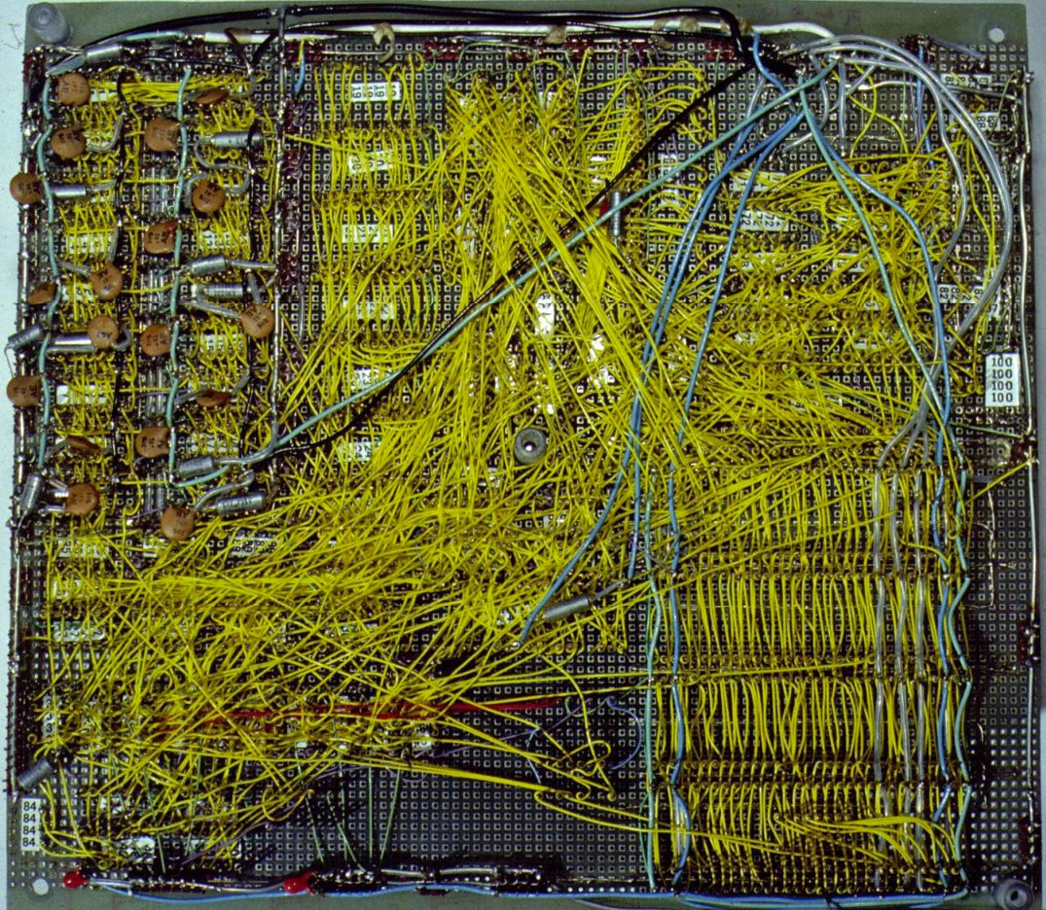
Original IBM PC Prototype Wire wrap board

Slide 10
LESSONS LEARNED FROM 6809 NANOCOMP SERIES
Videos were organised by project steps
Most videos too long – 30-60 minutes even when split into multiple parts
Large gaps of many weeks between publishing new videos
Video post-production takes longer (Editing, Subtitles and Reviewing)
Plan to keep videos to 15-20 minutes maximum
Publish more frequently - not based on completed project steps
All videos have reviewed/edited English sub-titles
Recommend view at 1.5+ times speed with sub-titles

Slide 11
High LEVEL PLAN
Nanocomp ‘8088’
Basic Floppy Disk PC
Disk, Mouse, Windows PC
Clock and Reset
CPU and NOP free run
Bus Controller, Latches & Buffers
EEPROM & RAM
LED Display & Keypad
Nanocomp C Monitor
Serial Port
Intel Hex file Load & Send
MDA Video Controller
PS/2 Keyboard Controller
Interrupt Controller
Timer
Real time clock
DMA Controller
Floppy Disk Controller
POST Port
BIOS
Boot MS-DOS from Floppy Disk
IDE Disk Controller
IDE BIOS
Boot MS-DOS from Hard Disk
CGA Video Controller
MCGA Enhancement
Serial PPP Networking (dial up)
PS/2 Mouse
Run Windows 1.0/2.0
Network adaptor
Sound Card

Slide 13
BREADBOARD PC 8088 #2 HIGH LEVEL DESIGN

Slide 14
High LEVEL PLAN
Nanocomp ‘8088’
Basic Floppy Disk PC
Disk, Mouse, Windows PC
Clock and Reset
CPU and NOP free run
Bus Controller, Latches & Buffers
EEPROM & RAM
LED Display & Keypad
Nanocomp C Monitor
Serial Port
Intel Hex file Load & Send
MDA Video Controller
PS/2 Keyboard Controller
Interrupt Controller
Timer
Real time clock
DMA Controller
Floppy Disk Controller
POST Port
BIOS
Boot MS-DOS from Floppy Disk
IDE Disk Controller
IDE BIOS
Boot MS-DOS from Hard Disk
CGA Video Controller
MCGA Enhancement
Serial PPP Networking (dial up)
PS/2 Mouse
Run Windows 1.0/2.0
Network adaptor
Sound Card

Slide 15
BACKGROUND INFO
Personal Computer World November 1981
The 8088 Project Book Robert Grossblatt 1989
PC-XT Technical Reference
PC-AT Technical Reference
PS/2 Technical Reference
Compaq Deskpro 386 Technical Reference 1986 and 1988 versions
Sergey Kiselev XI_8088 https://github.com/skiselev/xi_8088/tree/main
Wireless World July 1981 Nanocomp 6809 (LED Display and keypad)
KiCad schematic
Nanocomp Monitor in C

Slide 16
The 8088 Project Book Robert Grossblatt
My favourite “Laws of Life and Design” https://archive.org/details/the_8088_project_book_grossblatt_robert_1989
Golden rule “Think for yourself”
Dynamic RAM - “Using dynamic RAM in a single board system like ours is, in words of two syllables, a mistake.”
1 Know what you want to do before you try to do it
4 There's no substitute for a data sheet
8 If you can't afford to blow it up you can't afford to use it
11 If you only see one solution, you don't understand the problem
17 Machine language gives you total control of everything
21 It's more important to get it working than get it perfect
28 Anything which can blow up will blow up
57 Important things only happen when you’re not watching them
80 A circuit of a thousand parts starts with an LED
93 Software, unlike life, lets you change horses in midstream

Slide 17
USE EARLY 1980s components WHERE POSSIBLE
The following exceptions for practicality, cost and/or availability
Static RAM over legacy Dynamic RAM – reduces chip count for buffers, no refresh, no wait states (Grossblatt “a mistake”)
Modern EEPROM over legacy EPROM – simplifies programming, no wait states or UV
Programmable logic devices (PLD) to simplify logic and decoding (used in mid 80’s designs)
3.5” Floppy Disk and PS/2 Keyboard & Mouse (introduced 1987)
2.5” SATA Hard Disk with SATA-IDE converter (Avoid legacy IDE disks & 12V PSU)
Video - VGA LCD Monitor at 640 x 400@70Hz vs Monochrome 720 x 350@50Hz

Slide 18
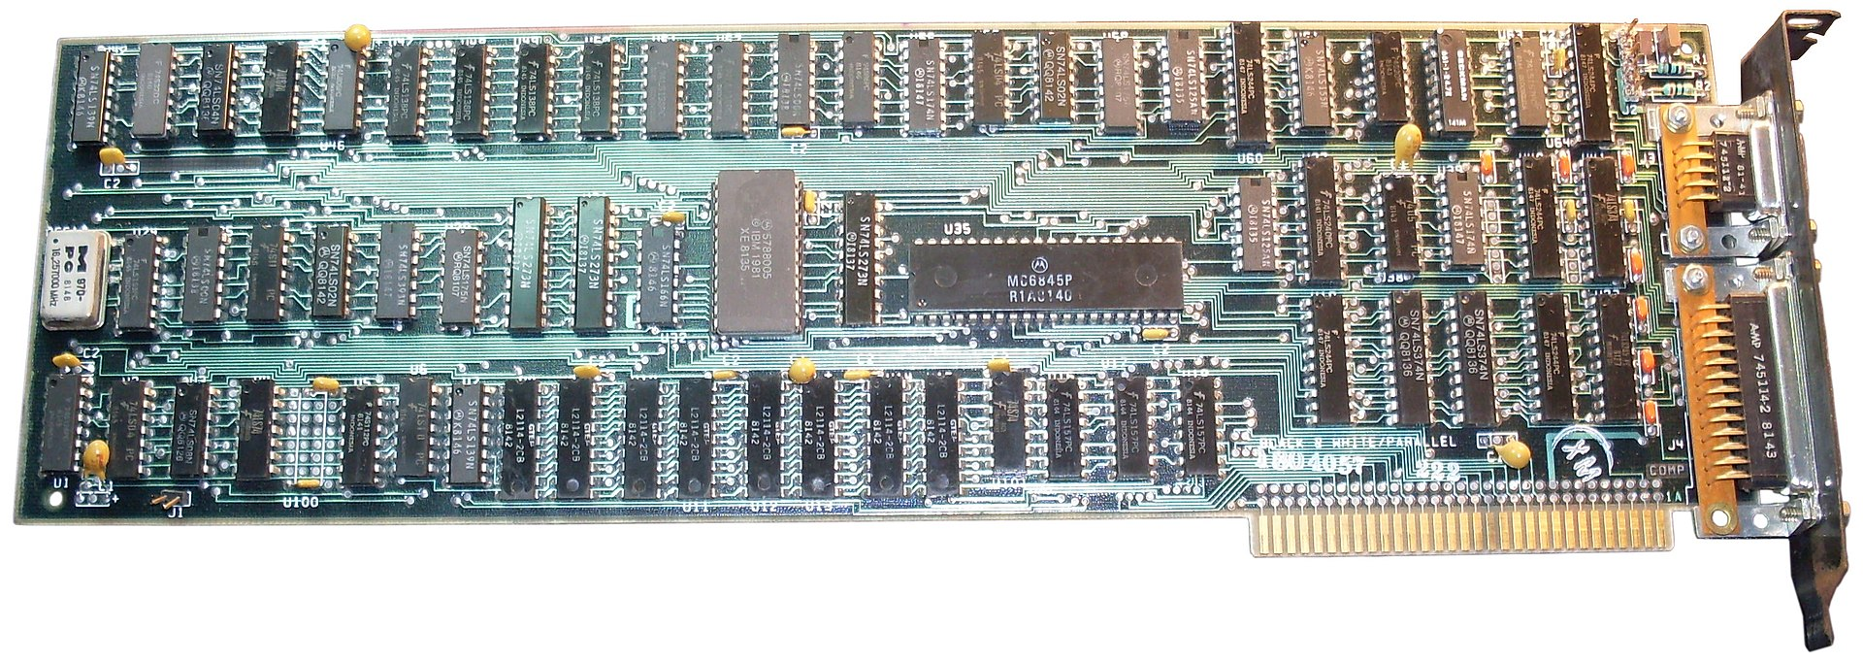
WHY MONOCHROME DISPLAY ADAPTOR (MDA)
Why not CGA/EGA/VGA?
Need PC compatibility for standard PC software to work
Nanocomp Video Controller produced VGA output but was not PC register compatible
MDA simpler to develop using dual port RAM
EGA and VGA used custom VLSI chips for control registers etc – 160 pin for breadboards!
MDA and other video cards can co-exist for debugging

Slide 19
MONOCHROME DISPLAY ADAPTOR (MDA)
Plan to develop CGA (or MCGA) in later stages of project
MDA has hard coded ROM based fonts and 4K Video RAM
No Parallel Port required
Use VGA Video DAC Palette chip as simpler to produce video output for VGA
MDA Adaptor could do 16 colours with some versions and colour monitor!
80 Columns by 25 rows, 1 byte character, 1 byte attributes/colour 4000 bytes
MDA 720 x 350 with 9 x 14 Characters at 50 Hz (18.4KHz Horizontal Sync)
Drop 9 pixel wide characters, make them 8 x 16 like VGA
MDA (VGA out) 640 pixels x 400 lines, 8 x 16 Characters at 70Hz (31.5KHz HS)

Slide 20
NanOCOMP ‘8088’ Block DIAGRAM
LED 7 Segment Display x 8
Digit 0-7
Seg A-G
14.3Mhz
Clock
Microprocessor Intel 8088
Buffers & Latches
Data Bus D0..D7
1-10 Decoder
Read Only
Memory (ROM)
Random Access Memory (RAM)
Peripheral Interface Adapter (PIA)
4+8 Decoder
Darlington
Driver
Reset & Clock
PB0-3
PA0-6
Row 0-3
Col 0-6
Address Bus A0..A19
Keypad 5 x 5
L
S
CN
G
RST
Control Signals (RST, MEMR/MEMW, IOR/IOW NMI, IRQ)
A
B
C
D
AB
Bus
Controller
A16, A17,A18,A19
RST NMI
7
8
9
E
M
Address Decoder
Memory Map
00000-7FFFF RAM (Y1)
80000-8FFFF PIA (Y4)
FFC00-FFFFF ROM (Y7)
4
5
6
F
R
1
2
3
0
I

Slide 21
High LEVEL PLAN
Nanocomp ‘8088’
Basic Floppy Disk PC
Disk, Mouse, Windows PC
Clock and Reset
CPU and NOP free run
Bus Controller, Latches & Buffers
EEPROM & RAM
LED Display & Keypad
Nanocomp C Monitor
Serial Port
Intel Hex file Load & Send
MDA Video Controller
PS/2 Keyboard Controller
Interrupt Controller
Timer
Real time clock
DMA Controller
Floppy Disk Controller
POST Port
BIOS
Boot MS-DOS from Floppy Disk
IDE Disk Controller
IDE BIOS
Boot MS-DOS from Hard Disk
CGA Video Controller
MCGA Enhancement
Serial PPP Networking (dial up)
PS/2 Mouse
Run Windows 1.0/2.0
Network adaptor
Sound Card

Slide 22
BREADBOARD 8088 PC#3 RESET & SUPERVISOR

Slide 23
High LEVEL PLAN
Nanocomp ‘8088’
Basic Floppy Disk PC
Disk, Mouse, Windows PC
Reset and Supervisor
Clock
CPU and NOP free run
Bus Controller, Latches & Buffers
EEPROM & RAM
LED Display & Keypad
Nanocomp C Monitor
Serial Port
Intel Hex file Load & Send
MDA Video Controller
PS/2 Keyboard Controller
Interrupt Controller
Timer
Real time clock
DMA Controller
Floppy Disk Controller
POST Port
BIOS
Boot MS-DOS from Floppy Disk
IDE Disk Controller
IDE BIOS
Boot MS-DOS from Hard Disk
CGA Video Controller
MCGA Enhancement
Serial PPP Networking (dial up)
PS/2 Mouse
Run Windows 1.0/2.0
Network adaptor
Sound Card

Slide 24
NanOCOMP ‘8088’ Block DIAGRAM
LED 7 Segment Display x 8
Digit 0-7
Seg A-G
14.3Mhz
Clock
Microprocessor Intel 8088
Buffers & Latches
Data Bus D0..D7
1-10 Decoder
Read Only
Memory (ROM)
Random Access Memory (RAM)
Peripheral Interface Adapter (PIA)
4+8 Decoder
Darlington
Driver
Reset & Clock
PB0-3
PA0-6
Row 0-3
Col 0-6
Address Bus A0..A19
Keypad 5 x 5
L
S
CN
G
RST
Control Signals (RST, MEMR/MEMW, IOR/IOW NMI, IRQ)
A
B
C
D
AB
Bus
Controller
A16, A17,A18,A19
RST NMI
7
8
9
E
M
Address Decoder
Memory Map
00000-7FFFF RAM (Y1)
80000-8FFFF PIA (Y4)
FFC00-FFFFF ROM (Y7)
4
5
6
F
R
1
2
3
0
I

Slide 25
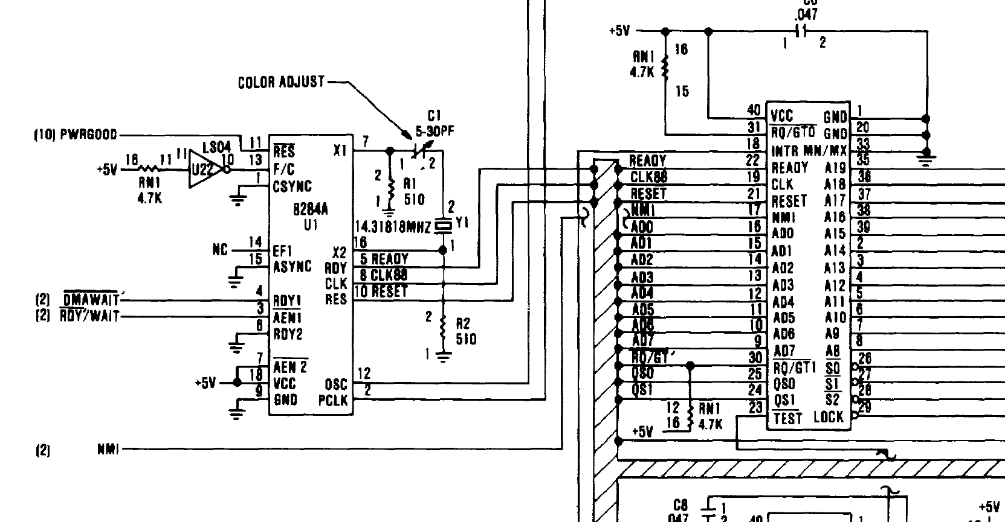
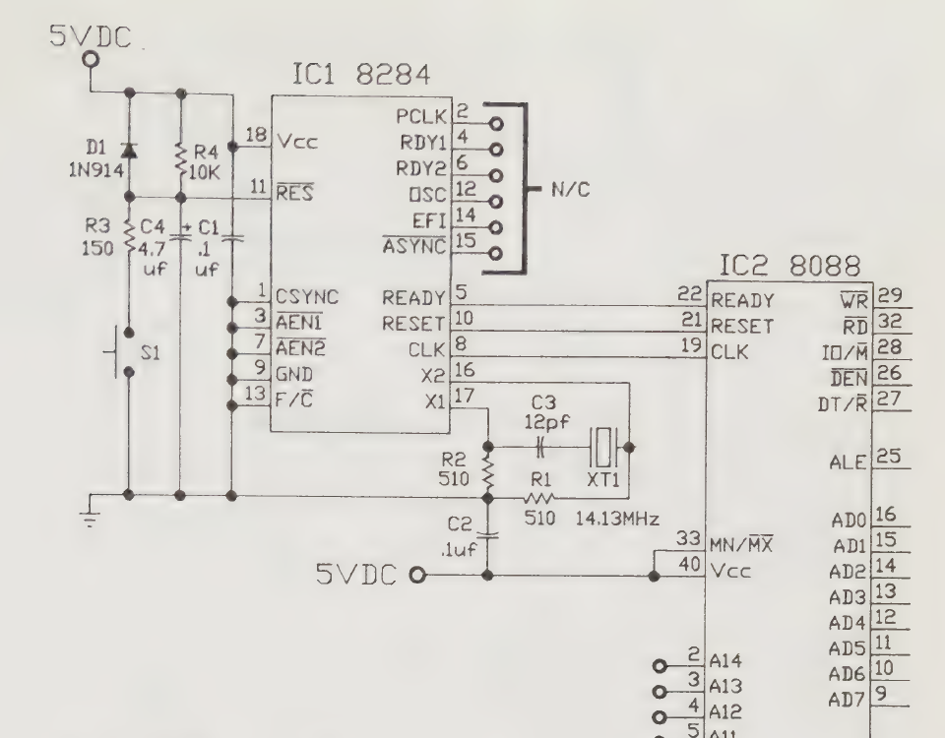

Slide 26
High LEVEL PLAN
Nanocomp ‘8088’
Basic Floppy Disk PC
Disk, Mouse, Windows PC
Reset and Supervisor
Clock
CPU and NOP free run
Bus Controller, Latches & Buffers
EEPROM & RAM
LED Display & Keypad
Nanocomp C Monitor
Serial Port
Intel Hex file Load & Send
MDA Video Controller
PS/2 Keyboard Controller
Interrupt Controller
Timer
Real time clock
DMA Controller
Floppy Disk Controller
POST Port
BIOS
Boot MS-DOS from Floppy Disk
IDE Disk Controller
IDE BIOS
Boot MS-DOS from Hard Disk
CGA Video Controller
MCGA Enhancement
Serial PPP Networking (dial up)
PS/2 Mouse
Run Windows 1.0/2.0
Network adaptor
Sound Card

Slide 27
BREADBOARD 8088 PC#4 CLOCK

Slide 28
High LEVEL PLAN
Nanocomp ‘8088’
Basic Floppy Disk PC
Disk, Mouse, Windows PC
Reset and Supervisor
Clock
CPU and NOP free run
Bus Controller, Latches & Buffers
EEPROM & RAM
LED Display & Keypad
Nanocomp C Monitor
Serial Port
Intel Hex file Load & Send
MDA Video Controller
PS/2 Keyboard Controller
Interrupt Controller
Timer
Real time clock
DMA Controller
Floppy Disk Controller
POST Port
BIOS
Boot MS-DOS from Floppy Disk
IDE Disk Controller
IDE BIOS
Boot MS-DOS from Hard Disk
CGA Video Controller
MCGA Enhancement
Serial PPP Networking (dial up)
PS/2 Mouse
Run Windows 1.0/2.0
Network adaptor
Sound Card

Slide 29
NanOCOMP ‘8088’ Block DIAGRAM
LED 7 Segment Display x 8
Digit 0-7
Seg A-G
14.3Mhz
Clock
Microprocessor Intel 8088
Buffers & Latches
Data Bus D0..D7
1-10 Decoder
Read Only
Memory (ROM)
Random Access Memory (RAM)
Peripheral Interface Adapter (PIA)
4+8 Decoder
Darlington
Driver
Reset & Clock
PB0-3
PA0-6
Row 0-3
Col 0-6
Address Bus A0..A19
Keypad 5 x 5
L
S
CN
G
RST
Control Signals (RST, MEMR/MEMW, IOR/IOW NMI, IRQ)
A
B
C
D
AB
Bus
Controller
A16, A17,A18,A19
RST NMI
7
8
9
E
M
Address Decoder
Memory Map
00000-7FFFF RAM (Y1)
80000-8FFFF PIA (Y4)
FFC00-FFFFF ROM (Y7)
4
5
6
F
R
1
2
3
0
I

Slide 31
The 8088 Project Book Robert Grossblatt
My favourite “Laws of Life and Design” https://archive.org/details/the_8088_project_book_grossblatt_robert_1989
Golden rule “Think for yourself”
Dynamic RAM - “Using dynamic RAM in a single board system like ours is, in words of two syllables, a mistake.”
1 Know what you want to do before you try to do it
4 There's no substitute for a data sheet
8 If you can't afford to blow it up you can't afford to use it
11 If you only see one solution, you don't understand the problem
17 Machine language gives you total control of everything
21 It's more important to get it working than get it perfect
28 Anything which can blow up will blow up
57 Important things only happen when you’re not watching them
80 A circuit of a thousand parts starts with an LED
93 Software, unlike life, lets you change horses in midstream

Slide 32
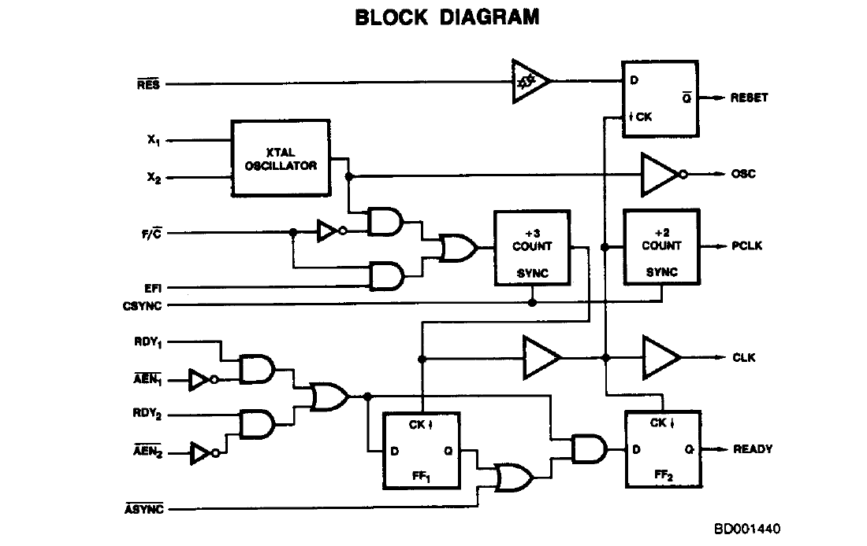
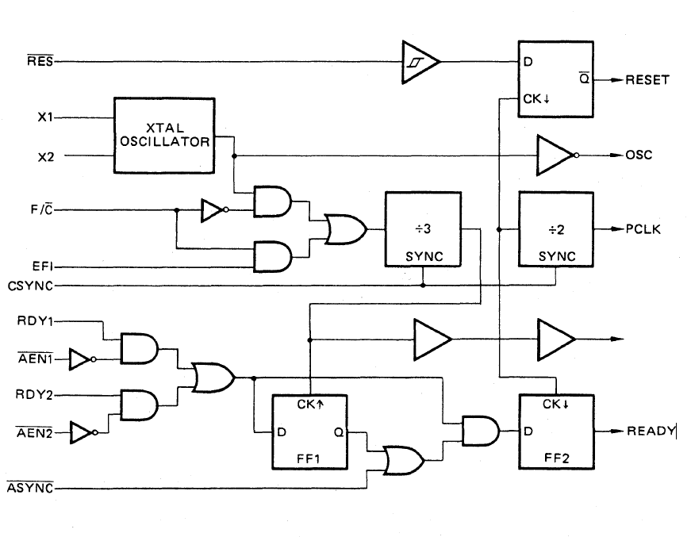
Intel 8284A
Fujitsu MBL8284A
CLK

Slide 33
High LEVEL PLAN
Nanocomp ‘8088’
Basic Floppy Disk PC
Disk, Mouse, Windows PC
Reset and Supervisor
Clock
CPU and NOP free run
Bus Controller, Latches & Buffers
EEPROM & RAM
LED Display & Keypad
Nanocomp C Monitor
Serial Port
Intel Hex file Load & Send
MDA Video Controller
PS/2 Keyboard Controller
Interrupt Controller
Timer
Real time clock
DMA Controller
Floppy Disk Controller
POST Port
BIOS
Boot MS-DOS from Floppy Disk
IDE Disk Controller
IDE BIOS
Boot MS-DOS from Hard Disk
CGA Video Controller
MCGA Enhancement
Serial PPP Networking (dial up)
PS/2 Mouse
Run Windows 1.0/2.0
Network adaptor
Sound Card

Slide 34
BREADBOARD 8088 PC#5 CPU NOP WITH LOGIC ANALYZER

Slide 35
High LEVEL PLAN
Nanocomp ‘8088’
Basic Floppy Disk PC
Disk, Mouse, Windows PC
Reset and Supervisor
Clock
CPU and NOP free run
Bus Controller, Latches & Buffers
EEPROM & RAM
LED Display & Keypad
Nanocomp C Monitor
Serial Port
Intel Hex file Load & Send
MDA Video Controller
PS/2 Keyboard Controller
Interrupt Controller
Timer
Real time clock
DMA Controller
Floppy Disk Controller
POST Port
BIOS
Boot MS-DOS from Floppy Disk
IDE Disk Controller
IDE BIOS
Boot MS-DOS from Hard Disk
CGA Video Controller
MCGA Enhancement
Serial PPP Networking (dial up)
PS/2 Mouse
Run Windows 1.0/2.0
Network adaptor
Sound Card

Slide 36
NanOCOMP ‘8088’ Block DIAGRAM
LED 7 Segment Display x 8
Digit 0-7
Seg A-G
14.3Mhz
Clock
Microprocessor Intel 8088
Buffers & Latches
Data Bus D0..D7
1-10 Decoder
Read Only
Memory (ROM)
Random Access Memory (RAM)
Peripheral Interface Adapter (PIA)
4+8 Decoder
Darlington
Driver
Reset & Clock
PB0-3
PA0-6
Row 0-3
Col 0-6
Address Bus A0..A19
Keypad 5 x 5
L
S
CN
G
RST
Control Signals (RST, MEMR/MEMW, IOR/IOW NMI, IRQ)
A
B
C
D
AB
Bus
Controller
A16, A17,A18,A19
RST NMI
7
8
9
E
M
Address Decoder
Memory Map
00000-7FFFF RAM (Y1)
80000-8FFFF PIA (Y4)
FFC00-FFFFF ROM (Y7)
4
5
6
F
R
1
2
3
0
I

Slide 37













Slide 38
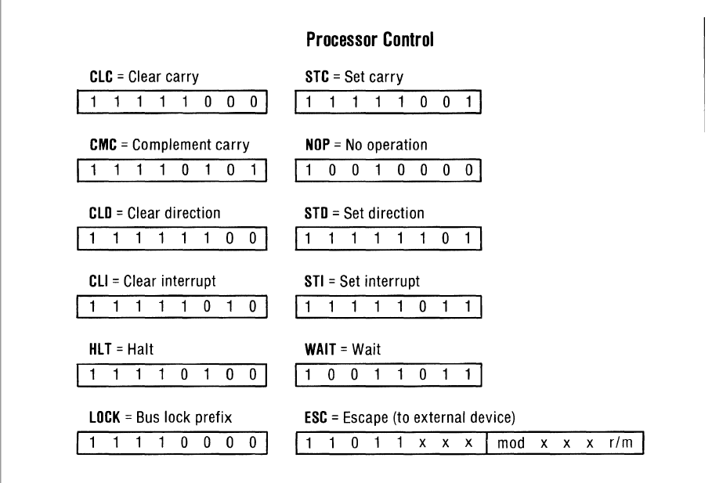
IBM PC-XT Technical Reference Guide Appendix B-15 page 449

Slide 39
High LEVEL PLAN
Nanocomp ‘8088’
Basic Floppy Disk PC
Disk, Mouse, Windows PC
Reset and Supervisor
Clock
CPU and NOP free run
Bus Controller, Latches & Buffers
EEPROM & RAM
LED Display & Keypad
Nanocomp C Monitor
Serial Port
Intel Hex file Load & Send
MDA Video Controller
PS/2 Keyboard Controller
Interrupt Controller
Timer
Real time clock
DMA Controller
Floppy Disk Controller
POST Port
BIOS
Boot MS-DOS from Floppy Disk
IDE Disk Controller
IDE BIOS
Boot MS-DOS from Hard Disk
CGA Video Controller
MCGA Enhancement
Serial PPP Networking (dial up)
PS/2 Mouse
Run Windows 1.0/2.0
Network adaptor
Sound Card

Slide 40
BREADBOARD 8088 PC #6 BUS CONTROLLER, LATCHES & BUFFERS

Slide 41
High LEVEL PLAN
Nanocomp ‘8088’
Basic Floppy Disk PC
Disk, Mouse, Windows PC
Reset and Supervisor
Clock
CPU and NOP free run
Bus Controller, Latches & Buffers
EEPROM & RAM
LED Display & Keypad
Nanocomp C Monitor
Serial Port
Intel Hex file Load & Send
MDA Video Controller
PS/2 Keyboard Controller
Interrupt Controller
Timer
Real time clock
DMA Controller
Floppy Disk Controller
POST Port
BIOS
Boot MS-DOS from Floppy Disk
IDE Disk Controller
IDE BIOS
Boot MS-DOS from Hard Disk
CGA Video Controller
MCGA Enhancement
Serial PPP Networking (dial up)
PS/2 Mouse
Run Windows 1.0/2.0
Network adaptor
Sound Card

Slide 42
NanOCOMP ‘8088’ Block DIAGRAM
LED 7 Segment Display x 8
Digit 0-7
Seg A-G
14.3Mhz
Clock
Microprocessor Intel 8088
Buffers & Latches
Data Bus D0..D7
1-10 Decoder
Read Only
Memory (ROM)
Random Access Memory (RAM)
Peripheral Interface Adapter (PIA)
4+8 Decoder
Darlington
Driver
Reset & Clock
PB0-3
PA0-6
Row 0-3
Col 0-6
Address Bus A0..A19
Keypad 5 x 5
L
S
CN
G
RST
Control Signals (RST, MEMR/MEMW, IOR/IOW NMI, IRQ)
A
B
C
D
AB
Bus
Controller
A16, A17,A18,A19
RST NMI
7
8
9
E
M
Address Decoder
Memory Map
00000-7FFFF RAM (Y1)
80000-8FFFF PIA (Y4)
FFC00-FFFFF ROM (Y7)
4
5
6
F
R
1
2
3
0
I

Slide 43
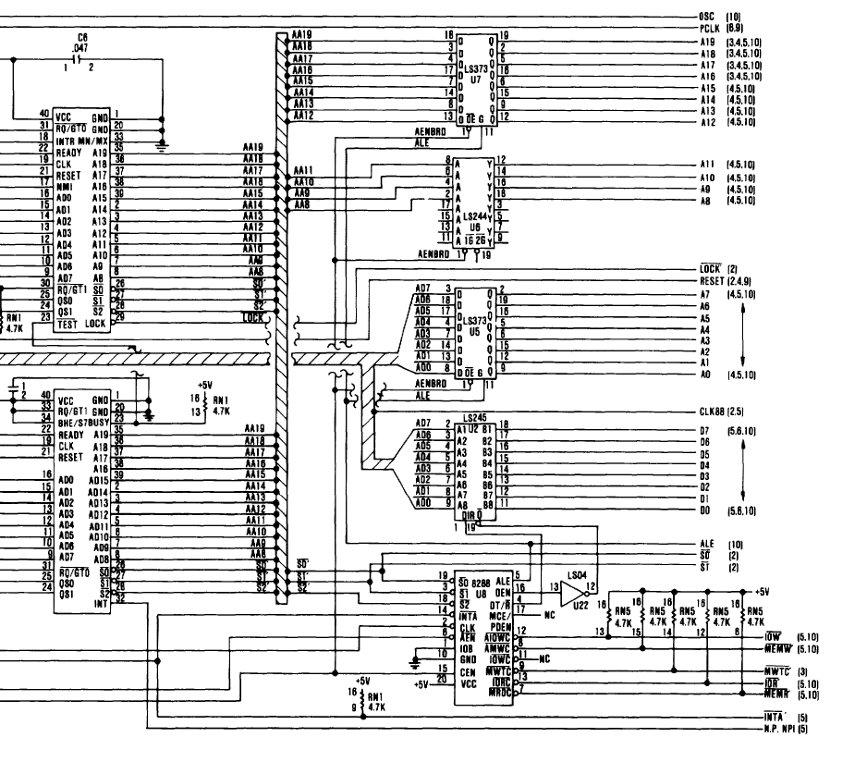
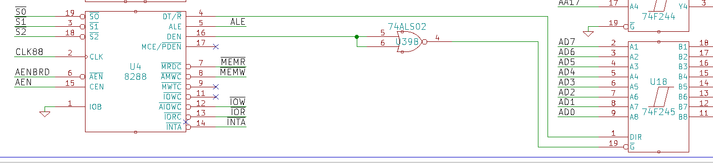














Slide 44
High LEVEL PLAN
Nanocomp ‘8088’
Basic Floppy Disk PC
Disk, Mouse, Windows PC
Reset and Supervisor
Clock
CPU and NOP free run
Bus Controller, Latches & Buffers
EEPROM & RAM
LED Display & Keypad
Nanocomp C Monitor
Serial Port
Intel Hex file Load & Send
MDA Video Controller
PS/2 Keyboard Controller
Interrupt Controller
Timer
Real time clock
DMA Controller
Floppy Disk Controller
POST Port
BIOS
Boot MS-DOS from Floppy Disk
IDE Disk Controller
IDE BIOS
Boot MS-DOS from Hard Disk
CGA Video Controller
MCGA Enhancement
Serial PPP Networking (dial up)
PS/2 Mouse
Run Windows 1.0/2.0
Network adaptor
Sound Card

Slide 45
BREADBOARD 8088 PC #7 EEPROM, RAM & ADDRESs DECODER

Slide 46
High LEVEL PLAN
Nanocomp ‘8088’
Basic Floppy Disk PC
Disk, Mouse, Windows PC
Reset and Supervisor
Clock
CPU and NOP free run
Bus Controller, Latches & Buffers
EEPROM, RAM & Address Decoder
LED Display & Keypad
Nanocomp C Monitor
Serial Port
Intel Hex file Load & Send
MDA Video Controller
PS/2 Keyboard Controller
Interrupt Controller
Timer
Real time clock
DMA Controller
Floppy Disk Controller
POST Port
BIOS
Boot MS-DOS from Floppy Disk
IDE Disk Controller
IDE BIOS
Boot MS-DOS from Hard Disk
CGA Video Controller
MCGA Enhancement
Serial PPP Networking (dial up)
PS/2 Mouse
Run Windows 1.0/2.0
Network adaptor
Sound Card

Slide 47
NanOCOMP ‘8088’ Block DIAGRAM
LED 7 Segment Display x 8
Digit 0-7
Seg A-G
14.3Mhz
Clock
Microprocessor Intel 8088
Buffers & Latches
Data Bus D0..D7
1-10 Decoder
Read Only
Memory (ROM)
Random Access Memory (RAM)
Peripheral Interface Adapter (PIA)
4+8 Decoder
Darlington
Driver
Reset & Clock
PB0-3
PA0-6
Row 0-3
Col 0-6
Address Bus A0..A19
Keypad 5 x 5
L
S
CN
G
RST
Control Signals (RST, MEMR/MEMW, IOR/IOW NMI, IRQ)
A
B
C
D
AB
Bus
Controller
A16, A17,A18,A19
RST NMI
7
8
9
E
M
Address Decoder
Memory Map
00000-7FFFF RAM (512K)
D0000-DFFFF PIA (64K)
F8000-FFFFF ROM (32K)
4
5
6
F
R
1
2
3
0
I

Slide 48
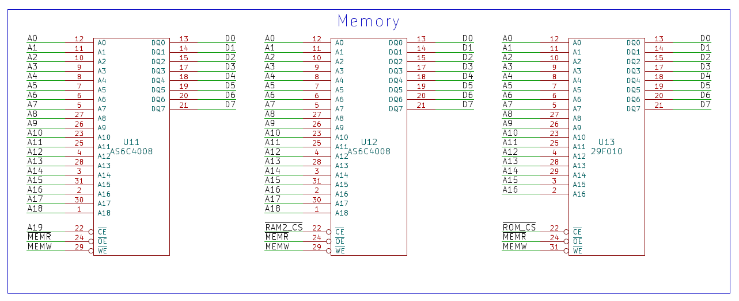
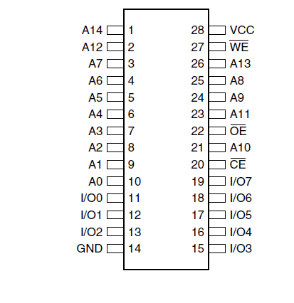











XI 8088 ROM AND RAM SCHEMATIC
AT28C256

Slide 49
High LEVEL PLAN
Nanocomp ‘8088’
Basic Floppy Disk PC
Disk, Mouse, Windows PC
Reset and Supervisor
Clock
CPU and NOP free run
Bus Controller, Latches & Buffers
EEPROM, RAM & Address Decoder
LED Display & Keypad
Nanocomp C Monitor
Serial Port
Intel Hex file Load & Send
MDA Video Controller
PS/2 Keyboard Controller
Interrupt Controller
Timer
Real time clock
DMA Controller
Floppy Disk Controller
POST Port
BIOS
Boot MS-DOS from Floppy Disk
IDE Disk Controller
IDE BIOS
Boot MS-DOS from Hard Disk
CGA Video Controller
MCGA Enhancement
Serial PPP Networking (dial up)
PS/2 Mouse
Run Windows 1.0/2.0
Network adaptor
Sound Card
Test Program in 8086 Assembler Testing Program in ROM
Writing to then reading from RAM

Slide 50
BREADBOARD 8088 PC #8 8086 ASSEMBLER & TESTING EEPROM & RAM

Slide 51
High LEVEL PLAN
Nanocomp ‘8088’
Basic Floppy Disk PC
Disk, Mouse, Windows PC
Reset and Supervisor
Clock
CPU and NOP free run
Bus Controller, Latches & Buffers
EEPROM, RAM & Address Decoder
LED Display & Keypad
Nanocomp C Monitor
Serial Port
Intel Hex file Load & Send
MDA Video Controller
PS/2 Keyboard Controller
Interrupt Controller
Timer
Real time clock
DMA Controller
Floppy Disk Controller
POST Port
BIOS
Boot MS-DOS from Floppy Disk
IDE Disk Controller
IDE BIOS
Boot MS-DOS from Hard Disk
CGA Video Controller
MCGA Enhancement
Serial PPP Networking (dial up)
PS/2 Mouse
Run Windows 1.0/2.0
Network adaptor
Sound Card
Test Program in 8086 Assembler Testing Program in ROM
Writing to then reading from RAM

Slide 52
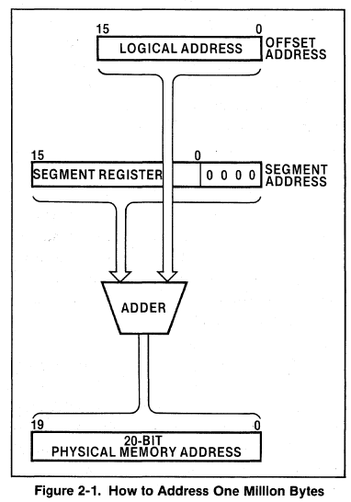
8086 ASSEMBLY LANGUAGE
Tool chain set up by Slador “Toolchain setup for 16-bit Intel 8088 and 80188 step by step”
https://www.youtube.com/watch?v=708uKGdqROk
NASM for Assembler
Xi 8088 / Sergey's XT BIOS for Reset handling https://github.com/skiselev/xi_8088
8086 Segmented Memory Model with 16-bit registers (64K) but 1 MB 20-bit address range
CS (code segment), DS (data segment), SS (stack segment), and ES (extra segment).
TESTRAM Program uses Data Segment Register – DS & Data Index Register – DI
Physical Address = DS x 16 (rotate Left 4) + DI
Reset Address FFFF0 = 1MB – 16 (10h), The CS register is set to FFFF 16, IP 0000
CS = FFFF, IP = 0000 [FFFF:0000]
Use DS and DI to access RAM
Can’t ADD CMP or TEST Segment registers, have to copy to another register first
Intel iAPX 88 BOOK http://bitsavers.informatik.uni-stuttgart.de/components/intel/8086/210200-002_iAPX88_Book_1983.pdf

Slide 53
High LEVEL PLAN
Nanocomp ‘8088’
Basic Floppy Disk PC
Disk, Mouse, Windows PC
Reset and Supervisor
Clock
CPU and NOP free run
Bus Controller, Latches & Buffers
EEPROM, RAM & Address Decoder
LED Display & Keypad
Nanocomp C Monitor
Serial Port
Intel Hex file Load & Send
MDA Video Controller
PS/2 Keyboard Controller
Interrupt Controller
Timer
Real time clock
DMA Controller
Floppy Disk Controller
POST Port
BIOS
Boot MS-DOS from Floppy Disk
IDE Disk Controller
IDE BIOS
Boot MS-DOS from Hard Disk
CGA Video Controller
MCGA Enhancement
Serial PPP Networking (dial up)
PS/2 Mouse
Run Windows 1.0/2.0
Network adaptor
Sound Card

Slide 54
BREADBOARD 8088 PC #9 LED DISPLAY & KEYPAD

Slide 55
High LEVEL PLAN
Nanocomp ‘8088’
Basic Floppy Disk PC
Disk, Mouse, Windows PC
Reset and Supervisor
Clock
CPU and NOP free run
Bus Controller, Latches & Buffers
EEPROM, RAM & Address Decoder
LED Display & Keypad
Nanocomp C Monitor
Serial Port
Intel Hex file Load & Send
MDA Video Controller
PS/2 Keyboard Controller
Interrupt Controller
Timer
Real time clock
DMA Controller
Floppy Disk Controller
POST Port
BIOS
Boot MS-DOS from Floppy Disk
IDE Disk Controller
IDE BIOS
Boot MS-DOS from Hard Disk
CGA Video Controller
MCGA Enhancement
Serial PPP Networking (dial up)
PS/2 Mouse
Run Windows 1.0/2.0
Network adaptor
Sound Card

Slide 56
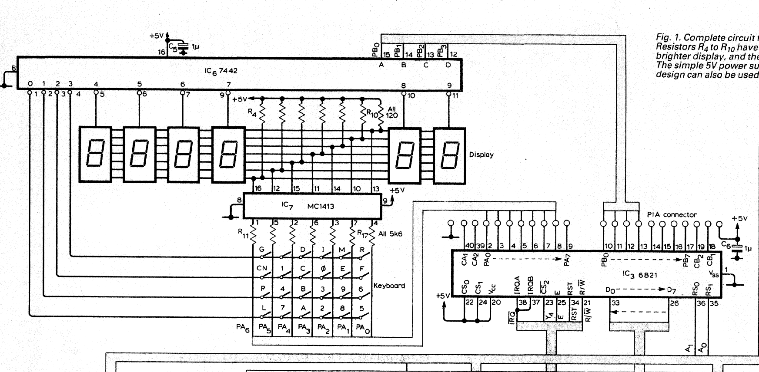
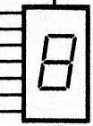

























Nanocomp Schematic
Wireless World July 1981

Slide 57
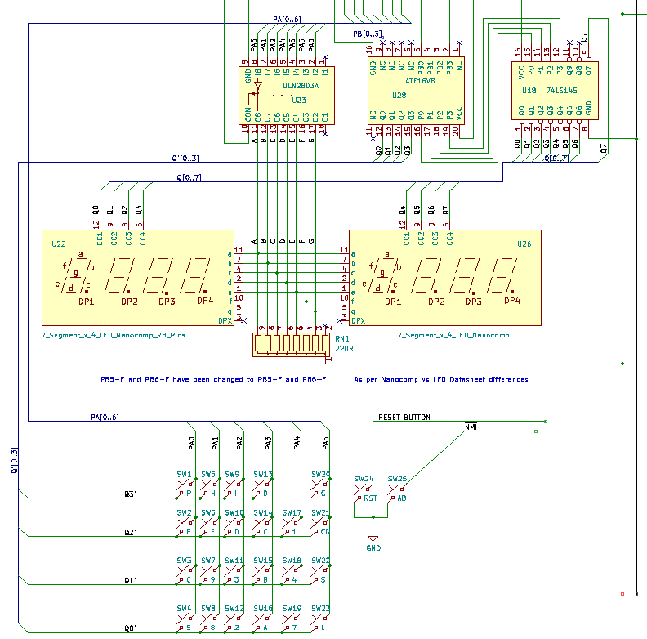
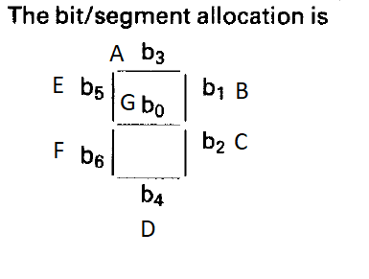
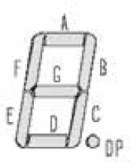
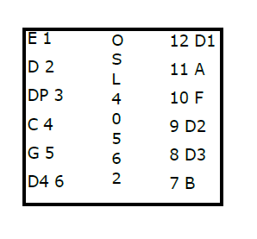
LED DISPLAY PIN MAPPING
PIA Signals
PA0-PA6
PB0-PB3
RESET
GND
NMI
PA3 - A
PA1 - B
PA2 - C
PA4 - D
PA5 - E
PA6 - F
PA0 - G

Slide 58
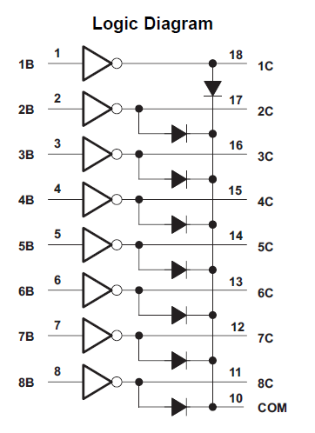
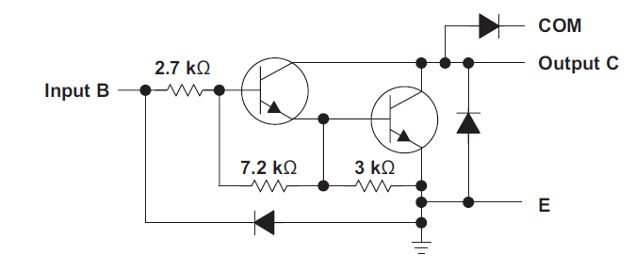
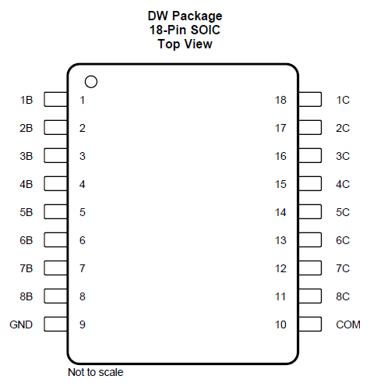
ULN2803A Darlington Transistor Array
No need for 5.6K from PA0-PA6
Direct connection OK
“The ULN2803A device has a 2.7-kΩ series base resistor for each Darlington pair for operation directly with TTL or 5-V CMOS devices.”

Slide 59
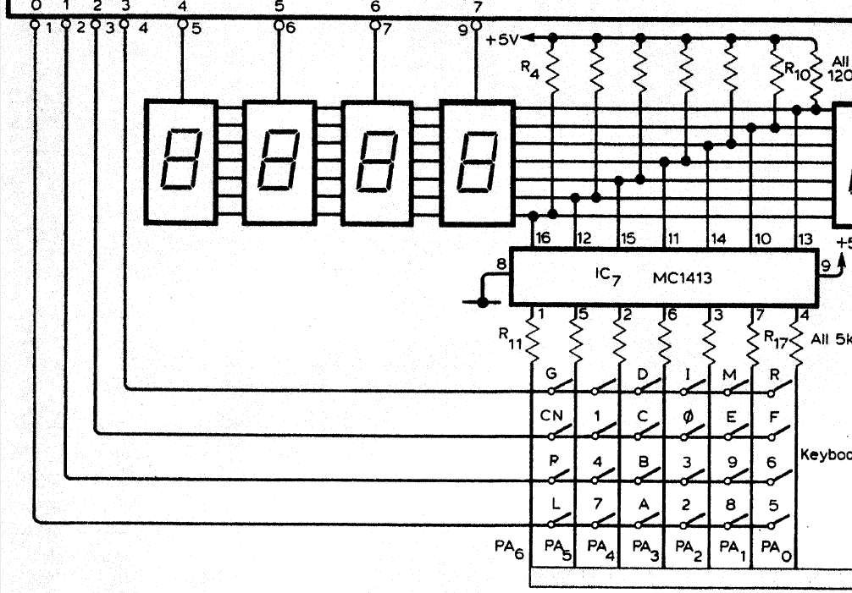

KEYPAD and DECODER
PIA Signals
PA0-PA6
PB0-PB3
RESET
GND
NMI
Keypad PA6

Slide 60
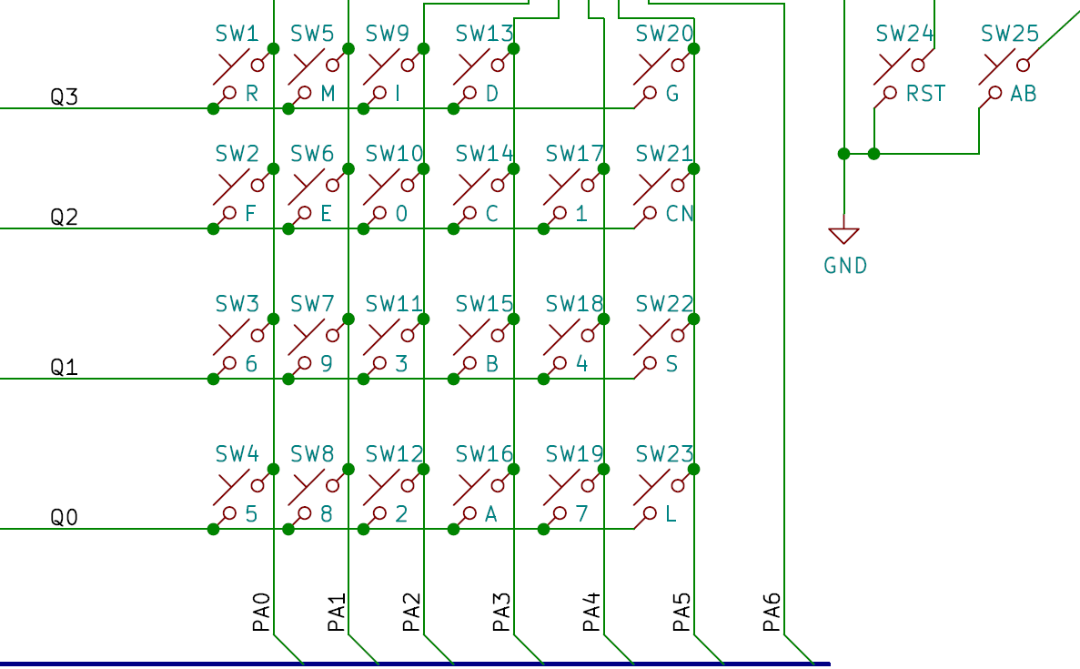
KEYPAD and DECODER
PA0 - 5 6 F R
PA1 - 8 9 E M
PA2 - 2 3 0 I
PA3 - A B C D
PA4 - 7 4 1
PA5 - L S CN G
PA6 -
Q0 - 5 8 2 A 7 L
Q1 - 6 9 3 B 4 S (P)
Q2 - F E 0 C 1 CN
Q3 - R M I D G
RST - RESET
AB - NMI

Slide 61
KEYPAD and DECODER
L Load | S Save | CN Continue | G Go | RST Reset
A | B | C | D | AB Abort
7 | 8 | 9 | E | M Memory
4 | 5 | 6 | F | R Register
1 | 2 | 3 | 0 | I Increment
 | PA0 | PA1 | PA2 | PA3 | PA4 | PA5 | PA6
Q0 | 5 | 8 | 2 | A | 7 | L | -
Q1 | 6 | 9 | 3 | B | 4 | S(P) | -
Q2 | F | E | 0 | C | 1 | CN | -
Q3 | R | M | I | D | - | G | -

Slide 62
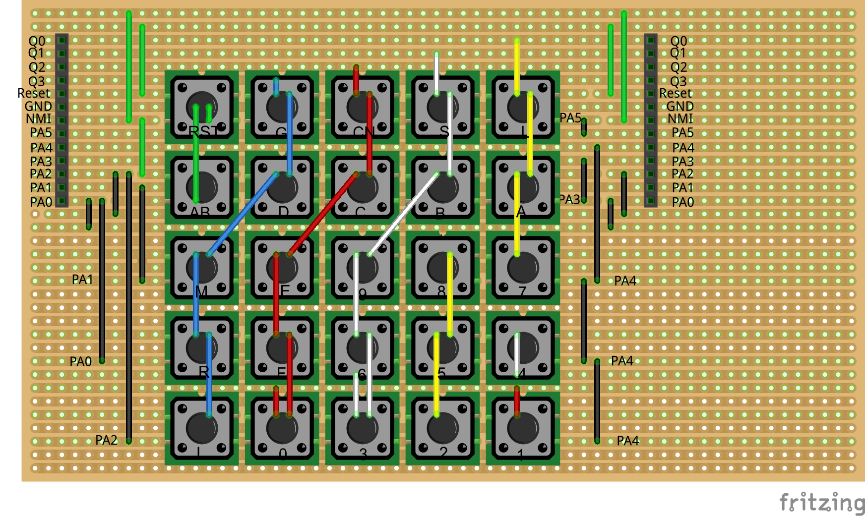
View from underside of stripboard

Slide 63
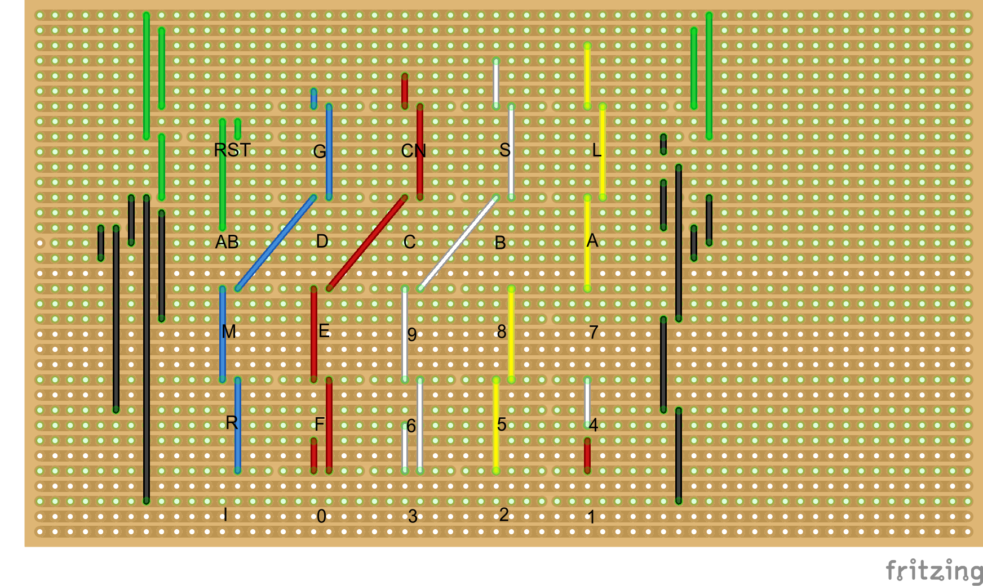
X
X
X
X
X
X
X
X
X
X
X
X
X
X
X
X
X
X
X
X
View from underside of stripboard,
parts hidden
X
X
X
X
X
X
X
X
X
X
X

Slide 64
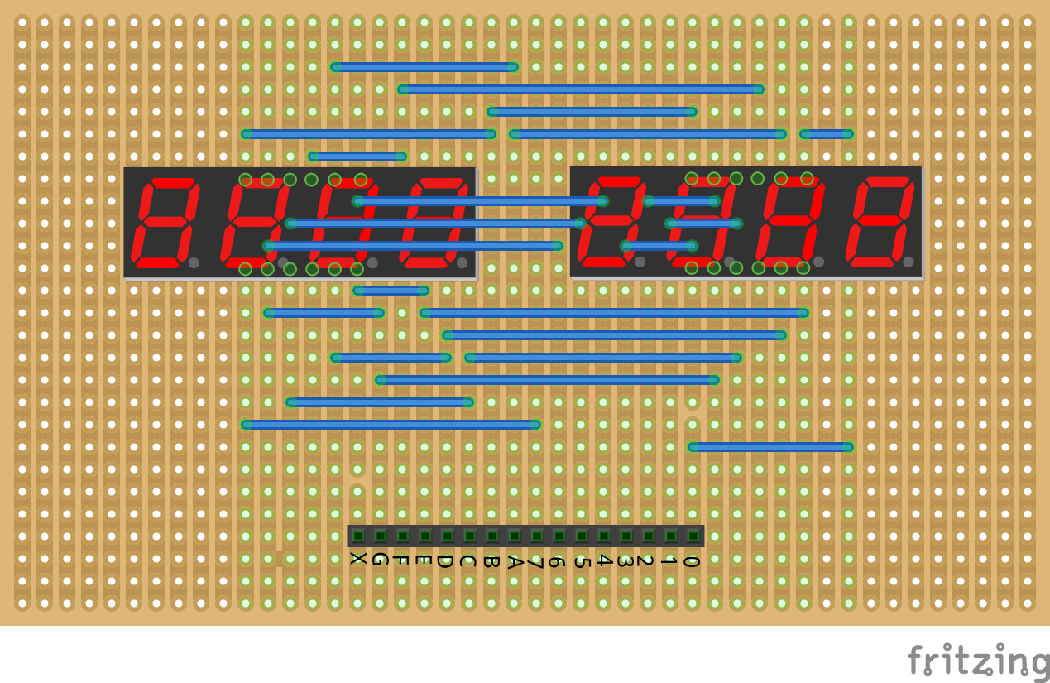
View from underside of stripboard

Slide 65
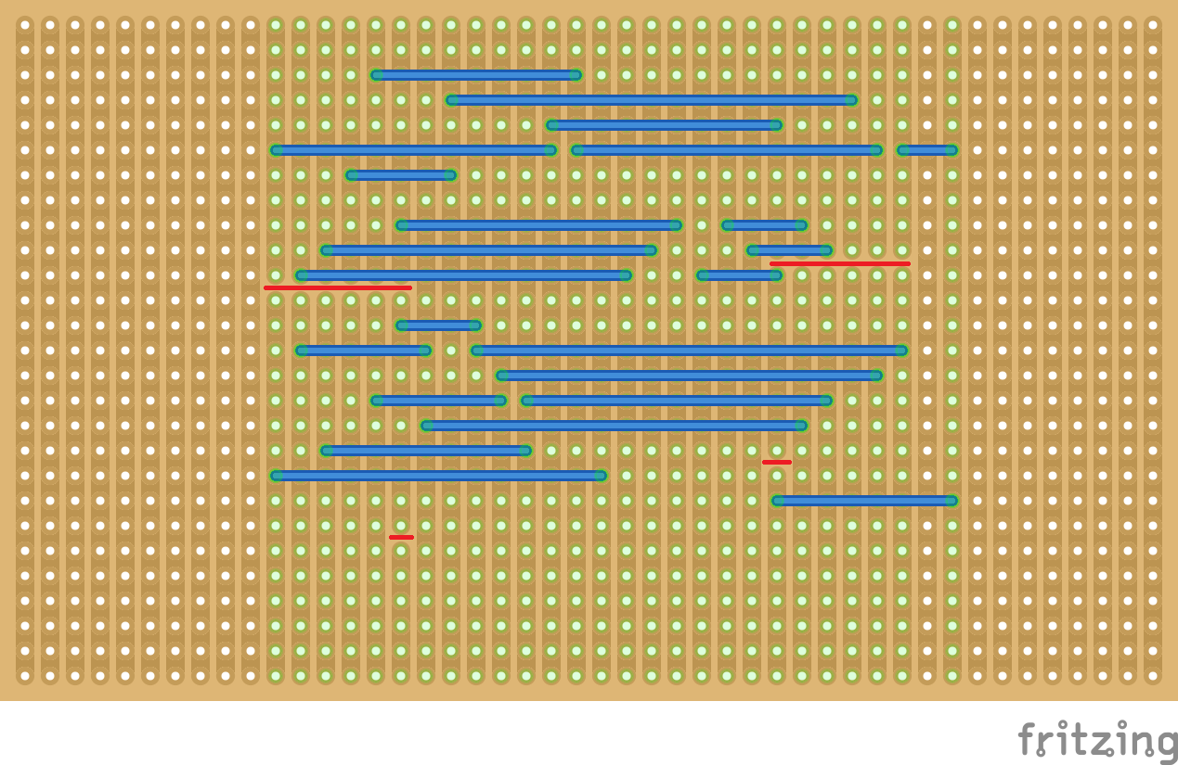
X
X
X
X
X
X
View from underside of stripboard,
parts hidden
X

Slide 66
Testing the Nanocomp 8088 – E & F SEGMENTS
Nanocomp design expects E & F reversed compared to 7 Segment LED Data sheet
Character values affected
2 4 5 9 d
PA0 - G
PA1 - B
PA2 - C
PA3 - A
PA4 - D
PA5 - E
PA6 - F
PA0 - G
PA1 - B
PA2 - C
PA3 - A
PA4 - D
PA5 - F
PA6 - E
Review Schematic Diagram
PA5 -> F
PA6 -> E

Slide 67
High LEVEL PLAN
Nanocomp ‘8088’
Basic Floppy Disk PC
Disk, Mouse, Windows PC
Reset and Supervisor
Clock
CPU and NOP free run
Bus Controller, Latches & Buffers
EEPROM, RAM & Address Decoder
LED Display & Keypad
Nanocomp C Monitor
Serial Port
Intel Hex file Load & Send
MDA Video Controller
PS/2 Keyboard Controller
Interrupt Controller
Timer
Real time clock
DMA Controller
Floppy Disk Controller
POST Port
BIOS
Boot MS-DOS from Floppy Disk
IDE Disk Controller
IDE BIOS
Boot MS-DOS from Hard Disk
CGA Video Controller
MCGA Enhancement
Serial PPP Networking (dial up)
PS/2 Mouse
Run Windows 1.0/2.0
Network adaptor
Sound Card
Look at Fritzing plans of display & Keypad
Test Program in 8086 Assembler
Program EEPROM
Check LED display and Key codes

Slide 68
BREADBOARD 8088 PC #10 LED DISPLAY & KEYPAD SOFTWARE & TESTING

Slide 69
High LEVEL PLAN
Nanocomp ‘8088’
Basic Floppy Disk PC
Disk, Mouse, Windows PC
Reset and Supervisor
Clock
CPU and NOP free run
Bus Controller, Latches & Buffers
EEPROM, RAM & Address Decoder
LED Display & Keypad
Nanocomp C Monitor
Serial Port
Intel Hex file Load & Send
MDA Video Controller
PS/2 Keyboard Controller
Interrupt Controller
Timer
Real time clock
DMA Controller
Floppy Disk Controller
POST Port
BIOS
Boot MS-DOS from Floppy Disk
IDE Disk Controller
IDE BIOS
Boot MS-DOS from Hard Disk
CGA Video Controller
MCGA Enhancement
Serial PPP Networking (dial up)
PS/2 Mouse
Run Windows 1.0/2.0
Network adaptor
Sound Card
Look at Fritzing plans of display & Keypad
Test Program in 8086 Assembler
Program EEPROM
Check LED display and Key codes

Slide 70
Nanocomp Schematic
Wireless World July 1981

Slide 71
KEYPAD and DECODER
L 0x05 | S 0x15 | CN 0x25 | G 0x35 | RST Reset
A 0x03 | B 0x13 | C 0x23 | D 0x33 | AB Abort
7 0x04 | 8 0x01 | 9 0x11 | E 0x21 | M 0x31
4 0x14 | 5 0x00 | 6 0x10 | F 0x20 | R 0x30
1 0x24 | 2 0x02 | 3 0x12 | 0 0x22 | I 0x32
 | PA0 | PA1 | PA2 | PA3 | PA4 | PA5 | PA6
Q0 | 5 | 8 | 2 | A | 7 | L | -
Q1 | 6 | 9 | 3 | B | 4 | S(P) | -
Q2 | F | E | 0 | C | 1 | CN | -
Q3 | R | M | I | D | - | G | -

Slide 72
View from underside of stripboard

Slide 73
X
X
X
X
X
X
X
X
X
X
X
X
X
X
X
X
X
X
X
X
View from underside of stripboard,
parts hidden
X
X
X
X
X
X
X
X
X
X
X

Slide 74
View from underside of stripboard

Slide 75
X
X
X
X
X
X
View from underside of stripboard,
parts hidden
X

Slide 76
High LEVEL PLAN
Nanocomp ‘8088’
Basic Floppy Disk PC
Disk, Mouse, Windows PC
Reset and Supervisor
Clock
CPU and NOP free run
Bus Controller, Latches & Buffers
EEPROM, RAM & Address Decoder
LED Display & Keypad
Nanocomp C Monitor
Serial Port
Intel Hex file Load & Send
MDA Video Controller
PS/2 Keyboard Controller
Interrupt Controller
Timer
Real time clock
DMA Controller
Floppy Disk Controller
POST Port
BIOS
Boot MS-DOS from Floppy Disk
IDE Disk Controller
IDE BIOS
Boot MS-DOS from Hard Disk
CGA Video Controller
MCGA Enhancement
Serial PPP Networking (dial up)
PS/2 Mouse
Run Windows 1.0/2.0
Network adaptor
Sound Card

Slide 77
BREADBOARD 8088 PC #11 NANOCOMP MONITOR TO 8086/8088

Slide 78
High LEVEL PLAN
Nanocomp ‘8088’
Basic Floppy Disk PC
Disk, Mouse, Windows PC
Reset and Supervisor
Clock
CPU and NOP free run
Bus Controller, Latches & Buffers
EEPROM, RAM & Address Decoder
LED Display & Keypad
Nanocomp C Monitor
Serial Port
Intel Hex file Load & Send
MDA Video Controller
PS/2 Keyboard Controller
Interrupt Controller
Timer
Real time clock
DMA Controller
Floppy Disk Controller
POST Port
BIOS
Boot MS-DOS from Floppy Disk
IDE Disk Controller
IDE BIOS
Boot MS-DOS from Hard Disk
CGA Video Controller
MCGA Enhancement
Serial PPP Networking (dial up)
PS/2 Mouse
Run Windows 1.0/2.0
Network adaptor
Sound Card

Slide 79
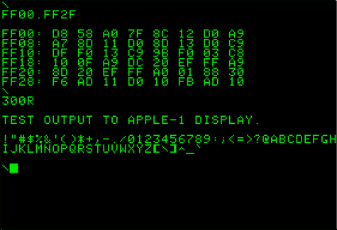
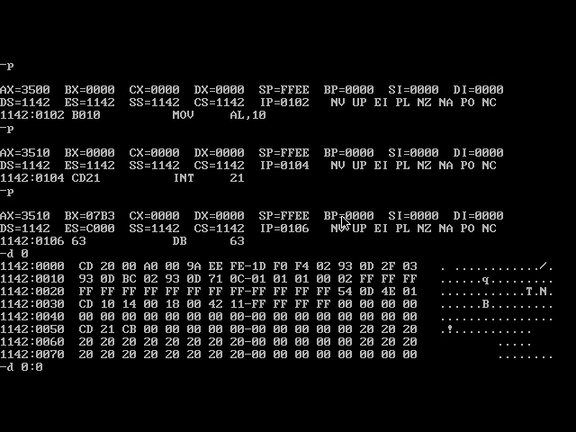
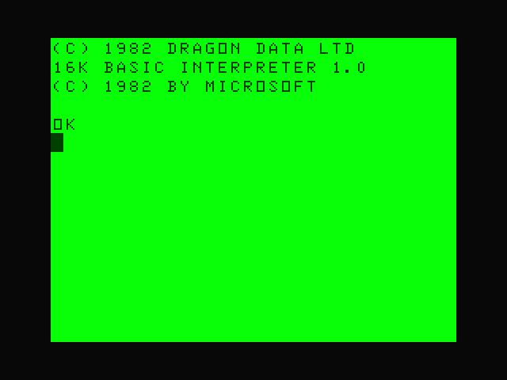
WHY DO WE NEED A MONITOR PROGRAM?
Apple I included WozMon in 248 bytes
Ben Eater https://youtu.be/HlLCtjJzHVI?si=C_-FtWSOUDYZLrdE
Tim Paterson (Seattle Computer Products) 86-DOS Early version of DEBUG in ROM, became DEBUG.EXE in MS-DOS
BASIC ROM in PET, BBC Micro, Spectrum, Dragon 32, TRS 80 etc provided similar features (but in 4K-16K)

Slide 80
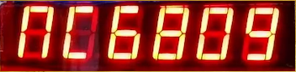
WHY DO WE NEED A MONITOR PROGRAM?
The Nanocomp Monitor is a very simple ‘operating system’ in 1K ROM
Initializes Stack, Reset & Interrupt Vectors (& 8088 Segment Registers)
Inspecting and changing memory
Executing programs
Displaying register values after breakpoints (SWI 0x3F, INT3 0xCC).
Loading and saving of memory over the serial port (originally was save/load to/from audio cassette) in S-Record Format (SREC)
Original Monitor in Motorola 6800 Assembly code
Updated to work with 6809 in July 1981
#12 Reverse Engineered/disassembled with help from Mike Spivey Nanocomp 6802 ROM disassembly https://github.com/Spivoxity/nanocomp/blob/master/rom.m68
Need 8088 Monitor to build & test hardware to run & debug an XT BIOS
When BIOS is operational, running MS-DOS possible

Slide 81
the Nanocomp MONITOR
Monitor Commands
M - Memory inspect/change
G - Go execute program at given address
S - Save to serial port in SREC
L - Load from serial port in SREC
CN - Continue from INT3
R - Register display after INT3
I - Increment, used by M and R
RS - Hard Reset, same as power cycle
AB - Abort Non Maskable Interrupt (NMI) – Display Registers
L 0x05 | S 0x15 | CN 0x25 | G 0x35 | RST Reset
A 0x03 | B 0x13 | C 0x23 | D 0x33 | AB Abort
7 0x04 | 8 0x01 | 9 0x11 | E 0x21 | M 0x31
4 0x14 | 5 0x00 | 6 0x10 | F 0x20 | R 0x30
1 0x24 | 2 0x02 | 3 0x12 | 0 0x22 | I 0x32

Slide 82
6809 – 8088 Conversion ISSUES
No PUSHA or POPA (only 80188+), have to do each register individually
Used JP and not JMP (Jump Parity!!, JP Is Z80 JMP)
Using CALL address (and code segment) in registers
needs indirect call to save address & code segment in RAM
No way to change segments from Monitor, use top 64K RAM 70000-7FFFF
CS – F000 (Monitor code in EEPROM)
DS – 7000
SS – 7000
ES – D000 (PIA and Serial Port)

Slide 83
High LEVEL PLAN
Nanocomp ‘8088’
Basic Floppy Disk PC
Disk, Mouse, Windows PC
Reset and Supervisor
Clock
CPU and NOP free run
Bus Controller, Latches & Buffers
EEPROM, RAM & Address Decoder
LED Display & Keypad
Nanocomp C Monitor
Serial Port, SREC Load & Save
Intel Hex file Load & Send
MDA Video Controller
PS/2 Keyboard Controller
Interrupt Controller
Timer
Real time clock
DMA Controller
Floppy Disk Controller
POST Port
BIOS
Boot MS-DOS from Floppy Disk
IDE Disk Controller
IDE BIOS
Boot MS-DOS from Hard Disk
CGA Video Controller
MCGA Enhancement
Serial PPP Networking (dial up)
PS/2 Mouse
Run Windows 1.0/2.0
Network adaptor
Sound Card

Slide 84
BREADBOARD 8088 PC #12 SERIAL PORT HARDWARE & SOFTWARE

Slide 85
High LEVEL PLAN
Nanocomp ‘8088’
Basic Floppy Disk PC
Disk, Mouse, Windows PC
Reset and Supervisor
Clock
CPU and NOP free run
Bus Controller, Latches & Buffers
EEPROM, RAM & Address Decoder
LED Display & Keypad
Nanocomp C Monitor
Serial Port, SREC Load & Save
Intel Hex file Load & Send
MDA Video Controller
PS/2 Keyboard Controller
Interrupt Controller
Timer
Real time clock
DMA Controller
Floppy Disk Controller
POST Port
BIOS
Boot MS-DOS from Floppy Disk
IDE Disk Controller
IDE BIOS
Boot MS-DOS from Hard Disk
CGA Video Controller
MCGA Enhancement
Serial PPP Networking (dial up)
PS/2 Mouse
Run Windows 1.0/2.0
Network adaptor
Sound Card

Slide 86
NanOCOMP ‘8088’ Block DIAGRAM
LED 7 Segment Display x 8
Digit 0-7
Seg A-G
14.3Mhz
Clock
Microprocessor Intel 8088
Buffers & Latches
Data Bus D0..D7
1-10 Decoder
Read Only
Memory (ROM)
Random Access Memory (RAM)
Peripheral Interface Adapter (PIA)
4+8 Decoder
Darlington
Driver
Reset & Clock
PB0-3
PA0-6
Row 0-3
Col 0-6
Address Bus A0..A19
Keypad 5 x 5
L
S
CN
G
RST
Control Signals (RST, MEMR/MEMW, IOR/IOW NMI, IRQ)
RST NMI
A
B
C
D
AB
Bus
Controller
A16, A17,A18,A19
Serial Port (ACIA/UART)
7
8
9
E
M
Address Decoder
Memory Map
00000-7FFFF RAM (512K)
D0000-DFFFF PIA & UART
F8000-FFFFF ROM (32K)
3.6Mhz
Clock
4
5
6
F
R
Baud Rate
3,686,400 Hz
÷ 16=230,400
÷ 64=57,600
Baud Rate
1,843,200 Hz
÷ 16=115,200
÷ 64=28,800
PC USB
1
2
3
0
I
FT232RL

Slide 87
SERIAL PORT & MONITOR SAVE/LOAD
Serial Port – Motorola MC68B50 ACIA
(Asynchronous Communication Interface Adapter)
Register Select x 1 and R/W control access to port and control registers
Clock divide by 1, 16 or 64 by control register
Interrupt on Transmit Data Register Empty (TDRE) or Receive Data Register Full (RDRF)
No need for RS-232 (+/- 12v), use FTDI Compatible Serial –TTL adaptor (FT232RL)
Virtual COM port on PC using USB (CDM v2.12.36.4 WHQL Certified driver)
FT232RL MC68B50
GND GND
/CTS /RTS – Request to Send Output same as /DTR
5V Not Connected – will power Nanocomp from PC
TX RX – cross over as DTE to DTE
RX TX – cross over as DTE to DTE
/RTS (Not /DTR) /CTS – Clear to Send Input

Slide 88
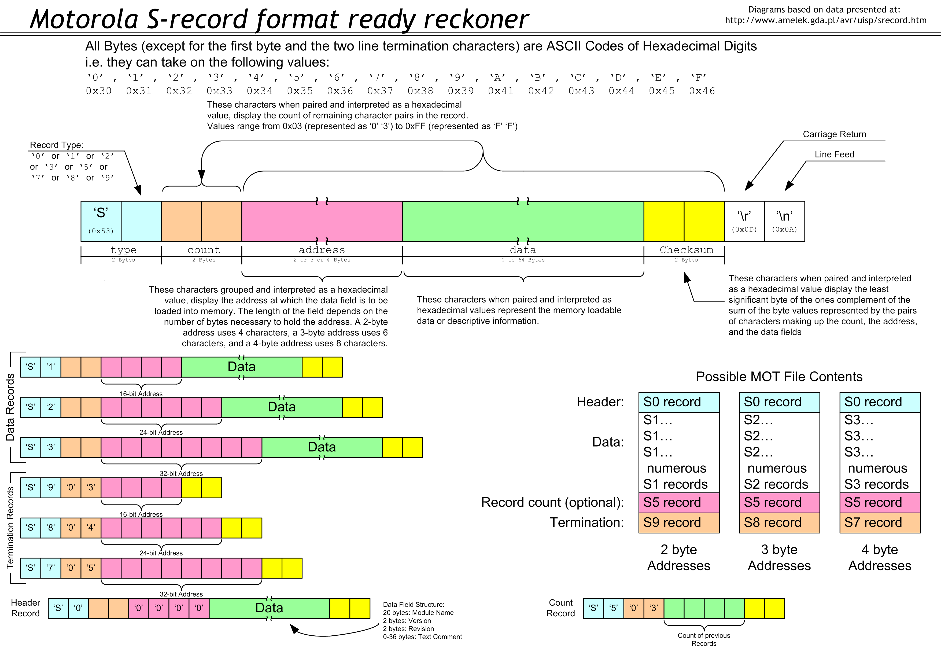
MOTOROLA S19-SREC FILE FORMAT
SREC Text format for binary assembler output
Record Type Hexadecimal Character
S1
Count 2 Char. No. of Bytes inc. Address & Checksum
Address 4 Char. 16 Bit Address in Hex
Data (Count – 3) x 2 Data Char.
Checksum Complement (Count + Address + Data values)
For No data Count=03 for Address + Checksum
S9
Count 03
Address 0000 Execution address not used
Checksum $FC (03 1’s complement NOT)
Notepad++ validates SREC and Checksum
LED Display F – Finished
C – Checksum Error
E – Hexadecimal conversion Error

Slide 89
High LEVEL PLAN
Nanocomp ‘8088’
Basic Floppy Disk PC
Disk, Mouse, Windows PC
Reset and Supervisor
Clock
CPU and NOP free run
Bus Controller, Latches & Buffers
EEPROM, RAM & Address Decoder
LED Display & Keypad
Nanocomp C Monitor
Serial Port, SREC Load & Save
Intel Hex file Load & Send
MDA Video Controller
PS/2 Keyboard Controller
Interrupt Controller
Timer
Real time clock
DMA Controller
Floppy Disk Controller
POST Port
BIOS
Boot MS-DOS from Floppy Disk
IDE Disk Controller
IDE BIOS
Boot MS-DOS from Hard Disk
CGA Video Controller
MCGA Enhancement
Serial PPP Networking (dial up)
PS/2 Mouse
Run Windows 1.0/2.0
Network adaptor
Sound Card

Slide 90
BREADBOARD 8088 PC #13 MONOCHROME DISPLAY ADAPTOR (MDA#1)

Slide 91
High LEVEL PLAN
Nanocomp ‘8088’
Basic Floppy Disk PC
Disk, Mouse, Windows PC
Reset and Supervisor
Clock
CPU and NOP free run
Bus Controller, Latches & Buffers
EEPROM, RAM & Address Decoder
LED Display & Keypad
Nanocomp C Monitor
Serial Port, SREC Load & Save
Intel Hex file Load & Send
MDA Video Controller
PS/2 Keyboard Controller
Interrupt Controller
Timer
Real time clock
DMA Controller
Floppy Disk Controller
POST Port
BIOS
Boot MS-DOS from Floppy Disk
IDE Disk Controller
IDE BIOS
Boot MS-DOS from Hard Disk
CGA Video Controller
MCGA Enhancement
Serial PPP Networking (dial up)
PS/2 Mouse
Run Windows 1.0/2.0
Network adaptor
Sound Card

Slide 92
WHY MONOCHROME DISPLAY ADAPTOR (MDA)
Why not CGA/EGA/VGA?
Need PC compatibility for standard PC software to work
Nanocomp 6809 Video Controller produced VGA output but was not PC register compatible
MDA simpler to develop using dual port RAM
EGA and VGA used custom VLSI chips for control registers etc – 144-160 pins for breadboards!
MDA and other video cards can co-exist for debugging

Slide 93
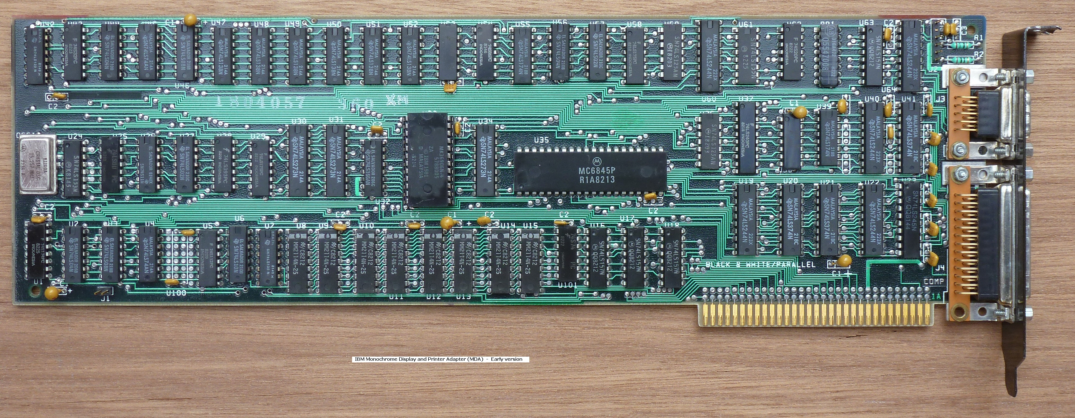
MC6845 CRTC, Character ROM, 8 RAM + 56 TTL logic chips
66 Chips in Total

Slide 94
MONOCHROME DISPLAY ADAPTOR (MDA)
Plan to develop CGA (or MCGA) in later stages of project
MDA has hard coded ROM based fonts and 4K Video RAM
No Parallel Port required
Use VGA Video DAC Palette chip - simpler for VGA video output for LCD Monitors
MDA Adaptor could do 16 colours with some versions and colour monitor!
https://www.seasip.info/VintagePC/mda.html#cmda
80 Columns by 25 rows, 1 byte character, 1 byte attributes/colour 4000 bytes
MDA 720 x 350 with 9 x 14 Characters at 50 Hz (18.4KHz Horizontal Sync)
Drop 9 pixel wide characters, make them 8 x 16 like VGA
MDA (VGA out) 640 pixels x 400 lines, 8 x 16 Characters at 70Hz (31.5KHz HS)

Slide 95
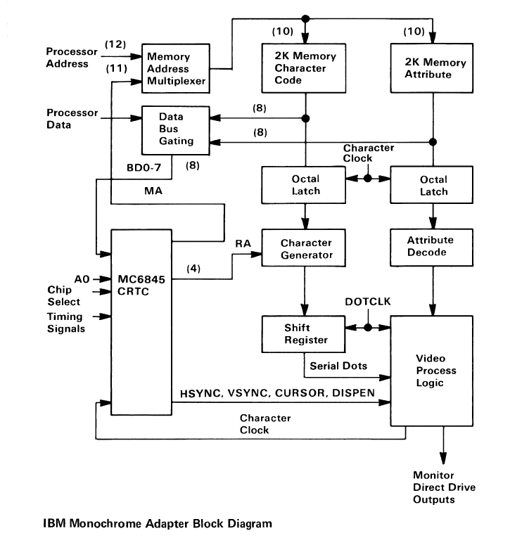

Slide 96
4K Dual Port RAM
HD68A45S
3.7Mhz Clk
Cursor Skew
Disp En. Skew
IMSG176 DAC
256 Colours
262K Palette

Slide 97
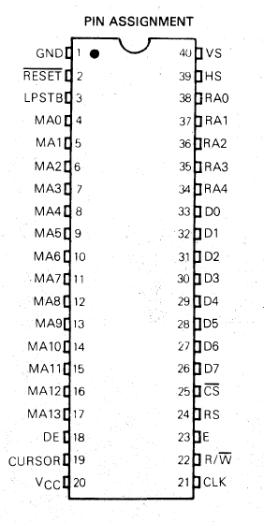
Why MOTOROLA 6845/HITACHI HD68A45S
Used by Commodore PET, BBC Micro and IBM MDA & CGA Adaptor
Flexible, not constrained like MC6847 (Dragon32, Tandy Color)
Can address 16K in characters with up to 32 rows (512KBytes total)
Designed for Character based but can be used for Graphics
Can work at 3+MHz Character clock (25.175/8 = 3.147MHz)
H Sync and V Sync may need to be inverted for some VGA Modes
Light pen not used

Slide 98
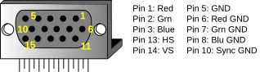
VGA VIDEO STANDARD
Introduced by IBM in PS/2 range in 1987
Analogue Red, Green, Blue colour signals between 0V and 0.7V
TTL Levels for Vertical Sync and Horizonal Sync (+ve & -ve)
Replaced MDA, CGA and EGA monitors (digital inputs)
256 Colour Palette 18 bit/262K (CGA 16, EGA 64)
Fonts 9x16 or 8x16 (8 wide, 16 high), 9x14 MDA, 8x8 CGA
15 Pin Sub Miniature ‘D’ Connector, Female for computer
Video Timing data http://tinyvga.com/vga-timing
VGA 640x480@60 Hz Industry standard (pixel clock 25.175 MHz) (30x80 characters)
VGA 640x400@70 Hz (pixel clock 25.175 MHz) (25x80 characters)

Slide 99
MOTOROLA 6845/HITACHI HD68A45S
2 Addresses configurable by 19 Registers (RS=0 Address, RS=1 Data)
VS – Vertical Sync, once per frame/page 70 Hz Refresh Rate
HS – Horizontal Sync, once per pixel row, 31.468KHz/31.77uS
Explanation of CRT and Sync
https://digilent.com/reference/learn/programmable-logic/tutorials/vga-display-congroller/start
6845 CRTC Register Timing https://mrboot.de/mc6845.php
Memory Address MA0-MA13 Selects character address in RAM
Row Address RA0-RA4 Selects character raster row from ROM
Cursor and Display enable signals need to be delayed by 1+ Char Clock
HD68A45S has Skew settings for Cursor & Display enable, 1-2 Char Clocks
CRTC MA0 to Video RAM VA1
Character Clock/2 as VA0 to switch RAM from Character to Attributes

Slide 100
High LEVEL PLAN
Nanocomp ‘8088’
Basic Floppy Disk PC
Disk, Mouse, Windows PC
Reset and Supervisor
Clock
CPU and NOP free run
Bus Controller, Latches & Buffers
EEPROM, RAM & Address Decoder
LED Display & Keypad
Nanocomp C Monitor
Serial Port, SREC Load & Save
Intel Hex file Load & Send
MDA Video Controller
PS/2 Keyboard Controller
Interrupt Controller
Timer
Real time clock
DMA Controller
Floppy Disk Controller
POST Port
BIOS
Boot MS-DOS from Floppy Disk
IDE Disk Controller
IDE BIOS
Boot MS-DOS from Hard Disk
CGA Video Controller
MCGA Enhancement
Serial PPP Networking (dial up)
PS/2 Mouse
Run Windows 1.0/2.0
Network adaptor
Sound Card

Slide 101
BREADBOARD 8088 PC #14 MONOCHROME DISPLAY ADAPTOR (MDA#2)

Slide 102
High LEVEL PLAN
Nanocomp ‘8088’
Basic Floppy Disk PC
Disk, Mouse, Windows PC
Reset and Supervisor
Clock
CPU and NOP free run
Bus Controller, Latches & Buffers
EEPROM, RAM & Address Decoder
LED Display & Keypad
Nanocomp C Monitor
Serial Port, SREC Load & Save
Intel Hex file Load & Send
MDA Video Controller
PS/2 Keyboard Controller
Interrupt Controller
Timer
Real time clock
DMA Controller
Floppy Disk Controller
POST Port
BIOS
Boot MS-DOS from Floppy Disk
IDE Disk Controller
IDE BIOS
Boot MS-DOS from Hard Disk
CGA Video Controller
MCGA Enhancement
Serial PPP Networking (dial up)
PS/2 Mouse
Run Windows 1.0/2.0
Network adaptor
Sound Card

Slide 103
4K Dual Port RAM
HD68A45S
3.7Mhz Clk
Cursor Skew
Disp En. Skew
2 x PLD
Video Out
Attribute Mux
IMSG176 DAC
256 Colours
262K Palette

Slide 104
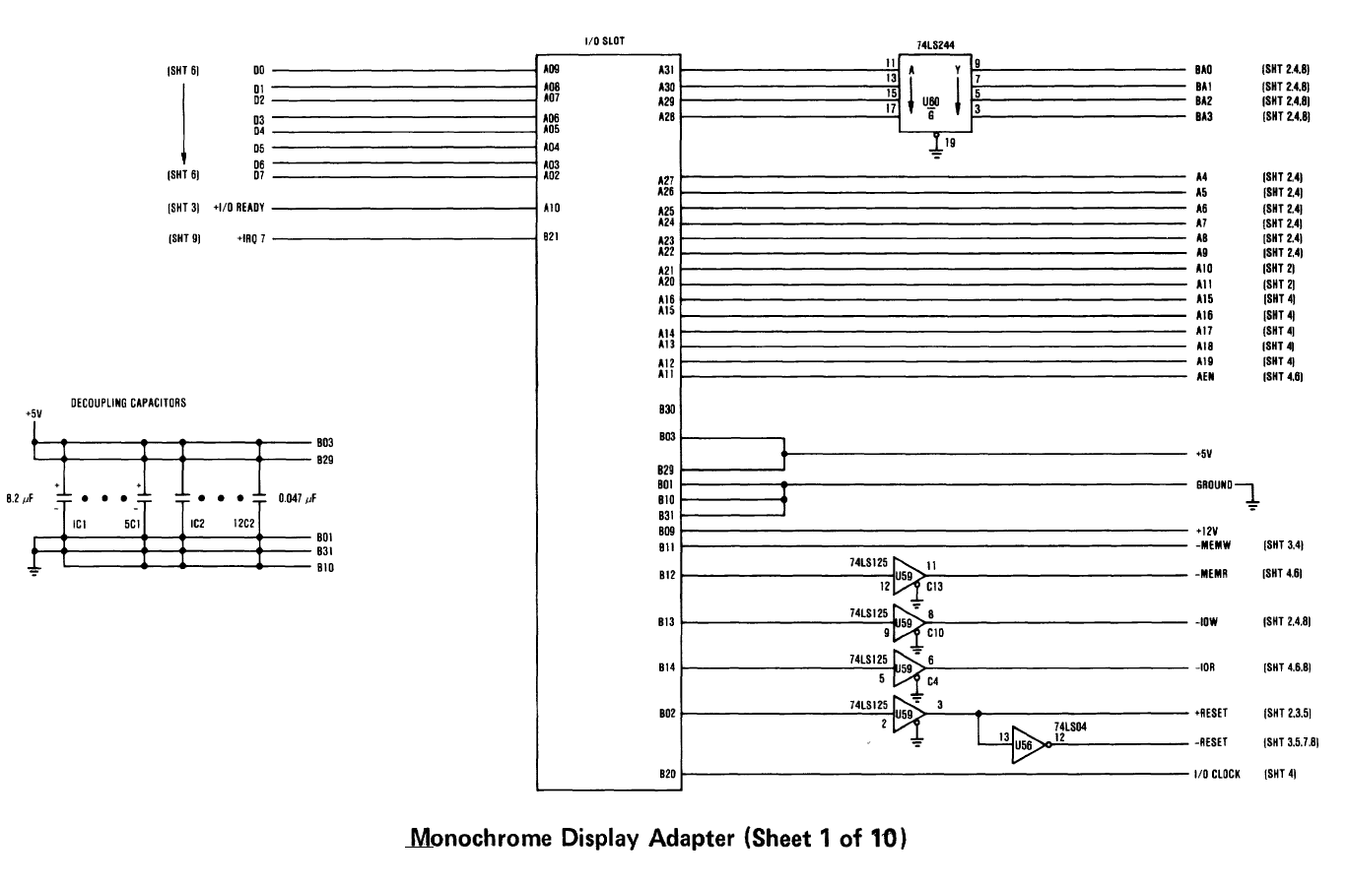
MDA #1
ISA Bus & Buffers

Slide 105
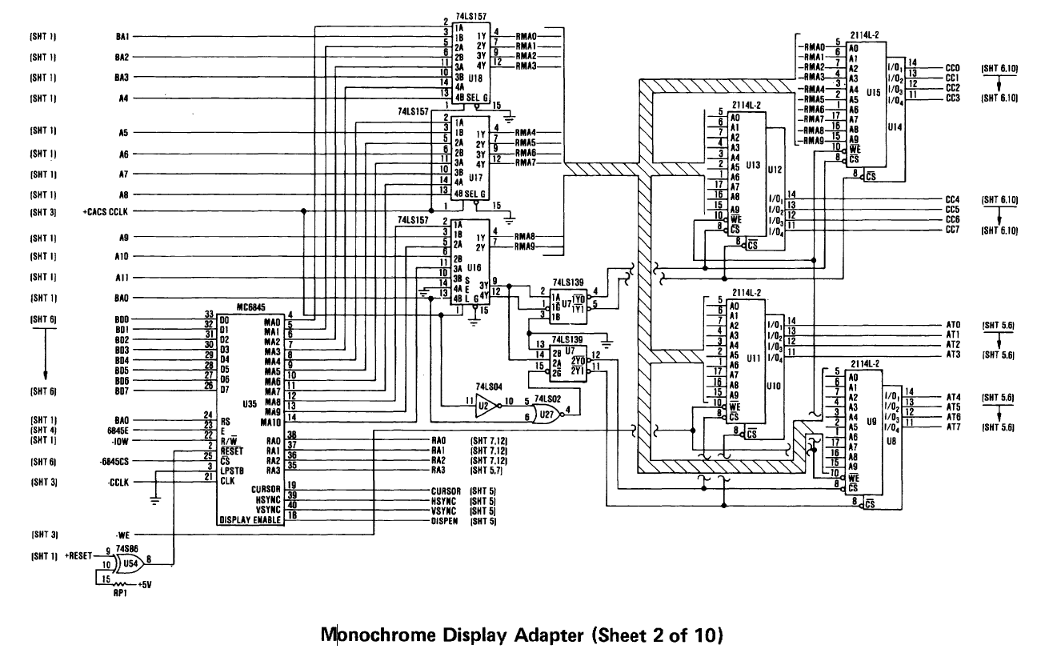




4K Dual Port RAM
CRTC Driven by
inverted Character Clock
MDA #2
CRTC, Video RAM and Address Multiplexers

Slide 106
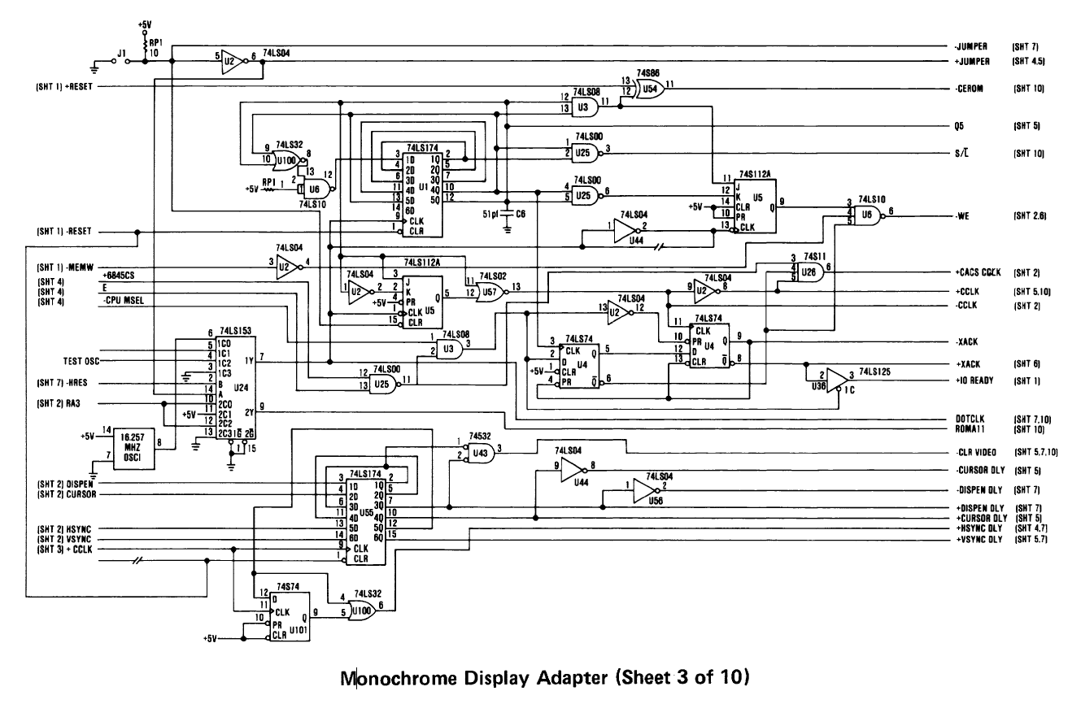













Jumper only used for IBM Testing - Ignore
Divide by 9 CharacterClock & Q5 S/L Latch
U100 OR gate!
NOR with U6
HRES must be 1
–HRES=0
A=0, B=0
-CLR Video goes low when both delayed DE 1Q and 3Q outputs are low, goes high on 1Q low to high. Used to clear some Flip flops and latches. May need to delay HS and VS by 1 CCLK.
MDA #3
Clocks, timing and delay logic
U43 is a 74S32 Quad OR gate, this works out to be a NOR which is wrong!

Slide 107
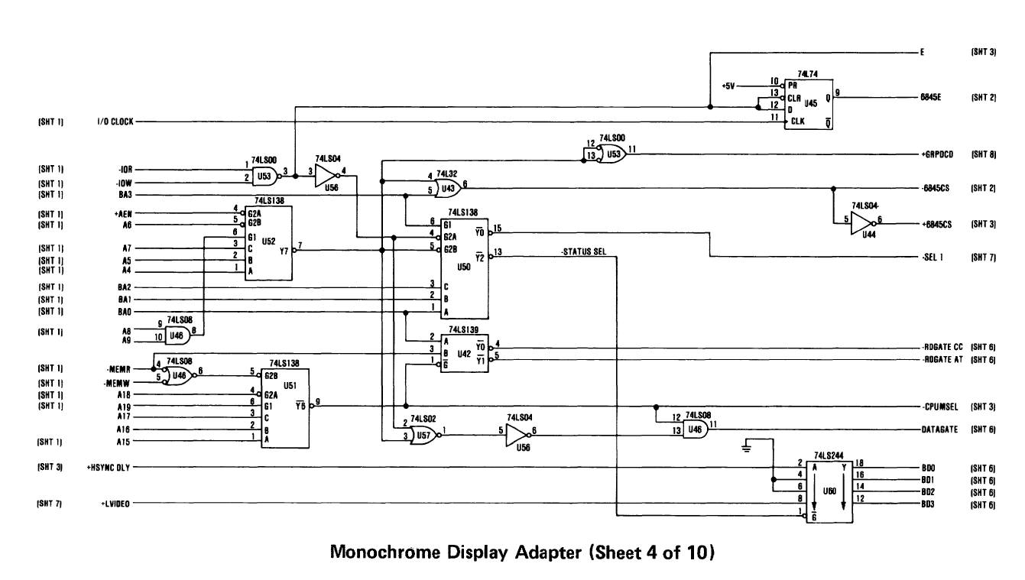
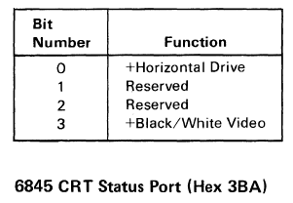
True MDA 1&2=0, 4-7=1
3B0-3BF
-SEL 1 CRT Control (3B8)
-STATUS SEL 1 CRT Status (3BA)
/Y6 A19,A17,A16=1 A15=0 B0000-B7FFF
MDA #4
Address Decoding, CRT Status Port (3BA)
CRT Status Port (3BA)

Slide 108
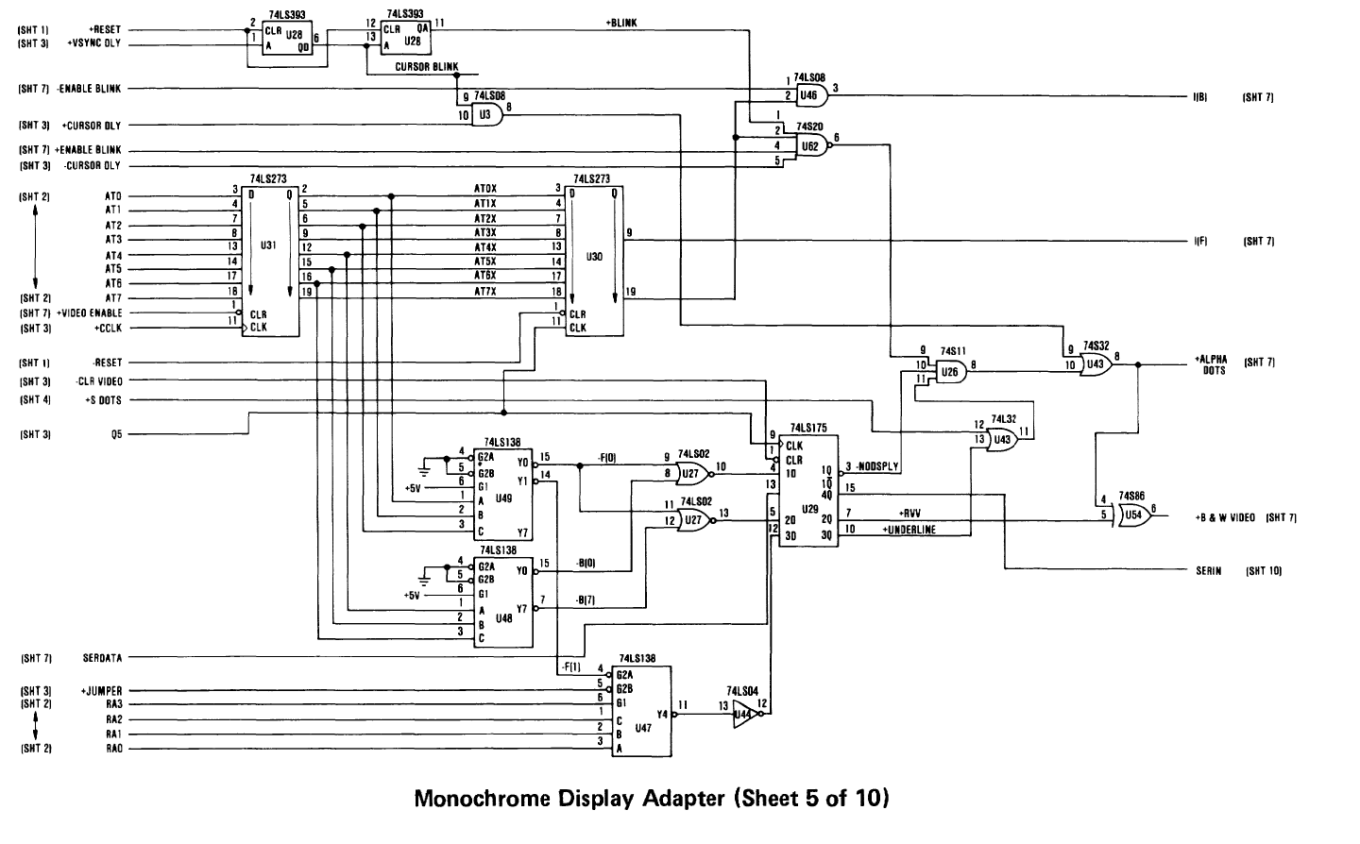
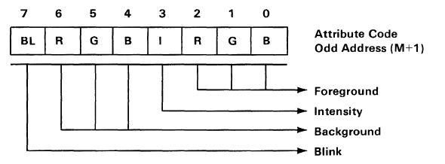
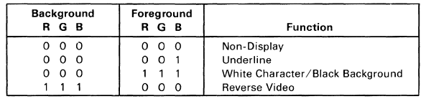
Character Blink freq. = Vert Sync / 32
Cursor Blink freq. = Vert Sync / 16
H
At7 Intensity Background,
Blink Disable
A
At7 Blink, Blink Enable, +Blink Chr,
-Cursor
C
At3 Intensity Foreground
Colour MDA
AlphaDots controls Mux for F&B Intensity, RVV does not reverse F/B Intensity!
At7 Blink
D
B
-CLR Video goes low with delayed DE but goes high 1 CClk BEFORE delayed DE
Fore Att at2,at1,at0
B&W Video controls output video & includes RVV
E
+S DOTS Output from Shift Reg. & Character Generator
G
F0,B0 Non-display,
B7 Reverse
Back Att at6,at5,at4
F
Underline F1 & row 12
MDA #5
Attribute and video control

Slide 109

Character Blink freq. = Vert Sync / 32
Cursor Blink freq. = Vert Sync / 16
At7 Intensity Background,
Blink Disable
A
At7 Blink, Blink Enable, +Blink Chr,
-Cursor
C
At3 Intensity Foreground
Colour MDA
At7 Blink
D
B
Fore Att at2,at1,at0
E
+S DOTS Output from Shift Reg. & Character Generator
G
F0,B0 Non-display,
B7 Reverse
Back Att at6,at5,at4
F
Underline F1 & row 12
MDA #5 Old version
Attribute and video control

Slide 110
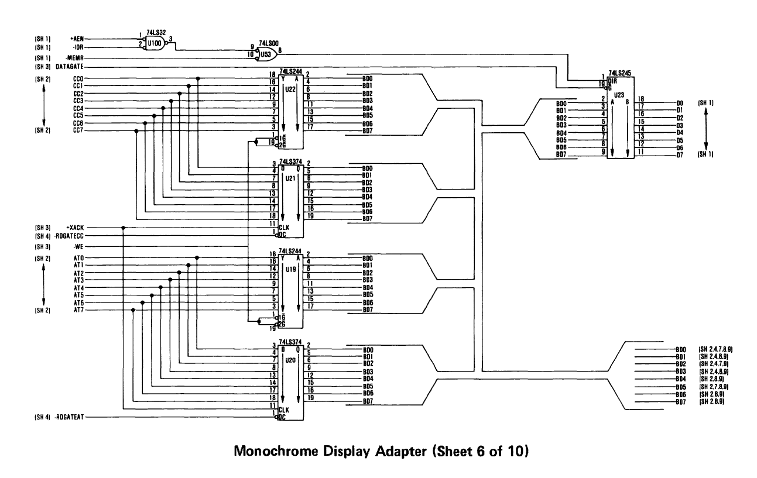
MDA #6
Data Bus Buffers & Latches

Slide 111





CRT Control Port (3B8)
Colour MDA
Colour MDA
Red, Green, Blue
Colour MDA
B/W
Extend C0h-DFh by 1 bit for 9 wide
CC7,CC6=1, CC5=0 C0-DF
MDA #7
Video Output & CRT Control Port (3B8)

Slide 112


Note JUMPER only used for IBM testing
But could select higher ROM 8x8 characters via A12
A12 = 0 for now
Right hand character bit to widen
Graphic characters C0h-DFh to 9 bits
Character Generator A0-A3=RA0-RA3
A4-A11=CC0-CC7, A12=0
-CLR Video goes low with delayed DE but goes high 1 ChClk BEFORE delayed DE
Character bits for
Graphic characters C0h-DFh to 9 bits
SERIN provides 9th pixel
MDA #10
Character Generator, Shift Register

Slide 113
BREADBOARD 8088 PC – MDA VIDEO DISPLAY
H Sync, V Sync, Display Enable, Cursor
Clock PLD
ATF22V10
H Sync
V Sync
Blink Clock
/Display Enable
CRTC MC6845
Character
Clock 3.146Mhz
Attributes/RGBI
Cursor
VGA
Dot Clock
Attribute
Multiplexer
ATF16V8
DAC
IMS G176
Character 0-255
(A4-A11)
D Type Latch
7ALS574
MA0
Dot Clk/4
D Type Latch
7ALS574
Video Out PLD
ATF22V10
Row 0-15 (A0-A3)
25.175Mhz
Memory Map
B0000-B0FFF VRAM
Port 3B0 Palette Add Wr
Port 3B1 Palette Colour
Port 3B2 Palette Mark
Port 3B3 Palette Add Rd
Port 3B4 CRTC Index
Port 3B5 CRTC Data
Port 3B8 CRT Control Port
Port 3BA CRT Status Port
Vid. Add.
Video RAM
Dual Port (4Kb)
Character Generator ROM
Shift Reg. Latch
Dot Clock
MA1-MA11
Fore/Back
Shift Register
74ALS166
Character raster
bits
Main Address Bus
Main Data Bus

Slide 114
BREADBOARD 8088 PC #15 MONOCHROME DISPLAY ADAPTOR (MDA#3)

Slide 115
High LEVEL PLAN
Nanocomp ‘8088’
Basic Floppy Disk PC
Disk, Mouse, Windows PC
Reset and Supervisor
Clock
CPU and NOP free run
Bus Controller, Latches & Buffers
EEPROM, RAM & Address Decoder
LED Display & Keypad
Nanocomp C Monitor
Serial Port, SREC Load & Save
Intel Hex file Load & Send
MDA Video Controller
PS/2 Keyboard Controller
Interrupt Controller
Timer
Real time clock
DMA Controller
Floppy Disk Controller
POST Port
BIOS
Boot MS-DOS from Floppy Disk
IDE Disk Controller
IDE BIOS
Boot MS-DOS from Hard Disk
CGA Video Controller
MCGA Enhancement
Serial PPP Networking (dial up)
PS/2 Mouse
Run Windows 1.0/2.0
Network adaptor
Sound Card

Slide 116
NanOCOMP ‘8088’ Block DIAGRAM – I/O PORT CHANGES
LED 7 Segment Display x 8
Digit 0-7
Seg A-G
14.3Mhz
Clock
Microprocessor Intel 8088
Buffers & Latches
Data Bus D0..D7
1-10 Decoder
Read Only
Memory (ROM)
Random Access Memory (RAM)
Peripheral Interface Adapter (PIA)
4+8 Decoder
Darlington
Driver
Reset & Clock
PB0-3
PA0-6
Row 0-3
Col 0-6
Address Bus A0..A19
Keypad 5 x 5
L
S
CN
G
RST
Control Signals (RST, MEMR/MEMW, IOR/IOW NMI, IRQ)
RST NMI
A
B
C
D
AB
Bus
Controller
A16, A17,A18,A19
Serial Port (ACIA/UART)
7
8
9
E
M
Address Decoder
Memory Map
00000-7FFFF RAM (512K)
IO D000,D100 PIA & UART
B0000-B7FFF MDA RAM (4K)
F8000-FFFFF ROM (32K)
4
5
6
F
R
Baud Rate
3,686,400 Hz
÷ 16=230,400
÷ 64=57,600
Baud Rate
1,843,200 Hz
÷ 16=115,200
÷ 64=28,800
3.6Mhz
Clock
PC USB
1
2
3
0
I
FT232RL

Slide 117
BREADBOARD 8088 PC – MDA VIDEO DISPLAY
H Sync, V Sync, Display Enable, Cursor
Clock PLD
ATF22V10
H Sync
V Sync
Blink Clock
/Display Enable
CRTC MC6845
Character
Clock 3.146Mhz
Attributes/RGBI
Cursor
VGA
Dot Clock
Attribute
Multiplexer
ATF16V8
DAC
IMS G176
Character 0-255
(A4-A11)
D Type Latch
7ALS574
MA0
Dot Clk/4
D Type Latch
7ALS574
Video Out PLD
ATF22V10
Row 0-15 (A0-A3)
25.175Mhz
Memory Map
B0000-B0FFF VRAM
Port 3B0 Palette Add Wr
Port 3B1 Palette Colour
Port 3B2 Palette Mark
Port 3B3 Palette Add Rd
Port 3B4 CRTC Index
Port 3B5 CRTC Data
Port 3B8 CRT Control Port
Port 3BA CRT Status Port
Vid. Add.
Video RAM
Dual Port (4Kb)
Character Generator ROM
Shift Reg. Latch
Dot Clock
MA1-MA11
Fore/Back
IO Port Decoder
Shift Register
74ALS166
Character raster
bits
Main Address Bus
Main Data Bus

Slide 118
Monochrome display adapter ACTIVITIES
Update main Address Decoder PLD for IOR/IOW, E, MDARAM & IO A19-A12 all zeros
Update Nanocomp Monitor EEPROM to use IO Ports, set Code and Data Segments
MDA IO Port Decoder PLD, 25 Mhz Dot Clock and Clock PLD
Video RAM, HD68A45S CRTC, IMS G176 Video DAC and 15 Pin VGA Sub D connector
Video Test software to initialize CRTC registers and Video DAC Palette, test basic video output
Character Latch, Character Generator EEPROM and Shift Register, test character output
Add CRT Status register and CRT Control Register and Blink Clock PLD
Add Attribute Latch, Attribute Multiplexer PLD and Video Output PLD
Test MDA Video Controller in ‘Black & White’ Monochrome
Test MDA Video Controller in Colour!

Slide 119
BREADBOARD 8088 PC #16 MONOCHROME DISPLAY ADAPTOR (MDA#4)

Slide 120
High LEVEL PLAN
Nanocomp ‘8088’
Basic Floppy Disk PC
Disk, Mouse, Windows PC
Reset and Supervisor
Clock
CPU and NOP free run
Bus Controller, Latches & Buffers
EEPROM, RAM & Address Decoder
LED Display & Keypad
Nanocomp C Monitor
Serial Port, SREC Load & Save
Intel Hex file Load & Send
MDA Video Controller
PS/2 Keyboard Controller
Timer & Speaker
POST Port
DMA Controller
Interrupt Controller
Real time clock
Floppy Disk Controller
BIOS
Boot MS-DOS from Floppy Disk
IDE Disk Controller
IDE BIOS
Boot MS-DOS from Hard Disk
CGA Video Controller
MCGA Enhancement
Serial PPP Networking (dial up)
PS/2 Mouse
Run Windows 1.0/2.0
Network adaptor
Sound Card

Slide 121
Monochrome display adapter ACTIVITIES
Update main Address Decoder PLD for IOR/IOW, E, MDARAM & IO A19-A12 all zeros
Update Nanocomp Monitor EEPROM to use IO Ports, set Code and Data Segments
MDA IO Port Decoder PLD, 25 Mhz Dot Clock and Clock PLD Test clock and IO decoder
Video RAM, HD68A45S CRTC, IMS G176 Video DAC and 15 Pin VGA Sub D connector
Video Test software to initialize CRTC registers and Video DAC Palette, test basic video output
Character Latch, Character Generator EEPROM and Shift Register, test character output
Add CRT Status register and CRT Control Register and Blink Clock PLD
Add Attribute Latch, Attribute Multiplexer PLD and Video Output PLD
Test MDA Video Controller in ‘Black & White’ Monochrome
Test MDA Video Controller in Colour!

Slide 122
BREADBOARD 8088 PC – MDA VIDEO DISPLAY
H Sync, V Sync, Display Enable
Clock PLD
ATF22V10
H Sync
V Sync
/Display Enable
CRTC MC6845
Character
Clock 3.146Mhz
VGA
Dot Clock
DAC
IMS G176
MA0
Dot Clk/4
25.175Mhz
Memory Map
B0000-B0FFF VRAM
Port 3B0 Palette Add Wr
Port 3B1 Palette Colour
Port 3B2 Palette Mark
Port 3B3 Palette Add Rd
Port 3B4 CRTC Index
Port 3B5 CRTC Data
Port 3B8 CRT Control Port
Port 3BA CRT Status Port
Vid. Add.
Video RAM
Dual Port (4Kb)
MA1-MA11
Dot Clock
IO Port Decoder
Main Address Bus
Main Data Bus

Slide 123
Monochrome display adapter ACTIVITIES
Update main Address Decoder PLD for IOR/IOW, E, MDARAM & IO A19-A12 all zeros
Update Nanocomp Monitor EEPROM to use IO Ports, set Code and Data Segments
MDA IO Port Decoder PLD, 25 Mhz Dot Clock and Clock PLD Test clock and IO decoder
Video RAM, HD68A45S CRTC, IMS G176 Video DAC and 15 Pin VGA Sub D connector
Video Test software to initialize CRTC registers and Video DAC Palette, test basic video output
Character Latch, Character Generator EEPROM and Shift Register, test character output
Add CRT Status register and CRT Control Register and Blink Clock PLD
Add Attribute Latch, Attribute Multiplexer PLD and Video Output PLD
Test MDA Video Controller in ‘Black & White’ Monochrome
Test MDA Video Controller in Colour!

Slide 124
BREADBOARD 8088 PC #17 MONOCHROME DISPLAY ADAPTOR (MDA#5)

Slide 125
Monochrome display adapter ACTIVITIES
Update main Address Decoder PLD for IOR/IOW, E, MDARAM & IO A19-A12 all zeros
Update Nanocomp Monitor EEPROM to use IO Ports, set Code and Data Segments
MDA IO Port Decoder PLD, 25 Mhz Dot Clock and Clock PLD Test clock and IO decoder
Video RAM, HD68A45S CRTC, IMS G176 Video DAC and 15 Pin VGA Sub D connector
Video Test software to initialize CRTC registers and Video DAC Palette, test basic video output
Character Latch, Character Generator EEPROM and Shift Register, test character output
Add CRT Status register and CRT Control Register and Blink Clock PLD
Add Attribute Latch, Attribute Multiplexer PLD and Video Output PLD
Test MDA Video Controller in ‘Black & White’ Monochrome
Test MDA Video Controller in Colour!

Slide 126
BREADBOARD 8088 PC – MDA VIDEO DISPLAY
H Sync, V Sync, Display Enable
Clock PLD
ATF22V10
H Sync
V Sync
/Display Enable
CRTC MC6845
Character
Clock 3.146Mhz
VGA
Dot Clock
DAC
IMS G176
MA0
Dot Clk/4
25.175Mhz
Memory Map
B0000-B0FFF VRAM
Port 3B0 Palette Add Wr
Port 3B1 Palette Colour
Port 3B2 Palette Mark
Port 3B3 Palette Add Rd
Port 3B4 CRTC Index
Port 3B5 CRTC Data
Port 3B8 CRT Control Port
Port 3BA CRT Status Port
Vid. Add.
Video RAM
Dual Port (4Kb)
MA1-MA11
Dot Clock
IO Port Decoder
Main Address Bus
Main Data Bus

Slide 127

BIOS & CGA COLOURS (ALSO MDA) – PC-XT Tech Reference
Brown CGA
IBM CGA Monitor changed Dark Yellow to Brown by reducing Green in hardware
White – Gray
Gray – Dark Gray

Slide 128
High LEVEL PLAN
Nanocomp ‘8088’
Basic Floppy Disk PC
Disk, Mouse, Windows PC
Reset and Supervisor
Clock
CPU and NOP free run
Bus Controller, Latches & Buffers
EEPROM, RAM & Address Decoder
LED Display & Keypad
Nanocomp C Monitor
Serial Port, SREC Load & Save
Intel Hex file Load & Send
MDA Video Controller
PS/2 Keyboard Controller
Interrupt Controller
Timer
Real time clock
DMA Controller
Floppy Disk Controller
POST Port
BIOS
Boot MS-DOS from Floppy Disk
IDE Disk Controller
IDE BIOS
Boot MS-DOS from Hard Disk
CGA Video Controller
MCGA Enhancement
Serial PPP Networking (dial up)
PS/2 Mouse
Run Windows 1.0/2.0
Network adaptor
Sound Card

Slide 129
Monochrome display adapter ACTIVITIES
Update main Address Decoder PLD for IOR/IOW, E, MDARAM & IO A19-A12 all zeros
Update Nanocomp Monitor EEPROM to use IO Ports, set Code and Data Segments
MDA IO Port Decoder PLD, 25 Mhz Dot Clock and Clock PLD
Video RAM, HD68A45S CRTC, IMS G176 Video DAC and 15 Pin VGA Sub D connector
Video Test software to initialize CRTC registers and Video DAC Palette, test basic video output
Character Latch, Character Generator EEPROM and Shift Register, test character output
Add CRT Status register and CRT Control Register and Blink Clock PLD
Add Attribute Latch, Attribute Multiplexer PLD and Video Output PLD
Test MDA Video Controller in ‘Black & White’ Monochrome
Test MDA Video Controller in Colour!

Slide 130


https://www.aceinnova.com/en/electronics/cga-and-the-brown-color-in-ibm-5153-color-display/

Slide 131
BREADBOARD 8088 PC #18 MONOCHROME DISPLAY ADAPTOR (MDA#6)

Slide 132
High LEVEL PLAN
Nanocomp ‘8088’
Basic Floppy Disk PC
Disk, Mouse, Windows PC
Reset and Supervisor
Clock
CPU and NOP free run
Bus Controller, Latches & Buffers
EEPROM, RAM & Address Decoder
LED Display & Keypad
Nanocomp C Monitor
Serial Port, SREC Load & Save
Intel Hex file Load & Send
MDA Video Controller
PS/2 Keyboard Controller
Interrupt Controller
Timer
Real time clock
DMA Controller
Floppy Disk Controller
POST Port
BIOS
Boot MS-DOS from Floppy Disk
IDE Disk Controller
IDE BIOS
Boot MS-DOS from Hard Disk
CGA Video Controller
MCGA Enhancement
Serial PPP Networking (dial up)
PS/2 Mouse
Run Windows 1.0/2.0
Network adaptor
Sound Card

Slide 133


Slide 134


Slide 135


Slide 136
Monochrome display adapter ACTIVITIES
Update main Address Decoder PLD for IOR/IOW, E, MDARAM & IO A19-A12 all zeros
Update Nanocomp Monitor EEPROM to use IO Ports, set Code and Data Segments
MDA IO Port Decoder PLD, 25 Mhz Dot Clock and Clock PLD
Video RAM, HD68A45S CRTC, IMS G176 Video DAC and 15 Pin VGA Sub D connector
Video Test software to initialize CRTC registers and Video DAC Palette, test basic video output
Character Latch, Character Generator EEPROM and Shift Register, test character output
Add CRT Status register and CRT Control Register and Blink Clock PLD
Add Attribute Latch, Attribute Multiplexer PLD and Video Output PLD
Test MDA Video Controller in ‘Black & White’ Monochrome
Test MDA Video Controller in Colour!

Slide 137
BREADBOARD 8088 PC – MDA VIDEO DISPLAY
H Sync, V Sync, Display Enable, Cursor
Clock PLD
ATF22V10
H Sync
V Sync
Blink Clock
/Display Enable
CRTC MC6845
Character
Clock 3.146Mhz
Attributes/RGBI
Cursor
VGA
Dot Clock
Attribute
Multiplexer
ATF16V8
DAC
IMS G176
Character 0-255
(A4-A11)
D Type Latch
7ALS574
MA0
Dot Clk/4
D Type Latch
7ALS574
Video Out PLD
ATF22V10
Row 0-15 (A0-A3)
25.175Mhz
Vid. Add.
Video RAM
Dual Port (4Kb)
Character Generator ROM
Memory Map
B0000-B0FFF VRAM
Port 3B0 Palette Add Wr
Port 3B1 Palette Colour
Port 3B2 Palette Mark
Port 3B3 Palette Add Rd
Port 3B4 CRTC Index
Port 3B5 CRTC Data
Port 3B8 CRT Control Port
Port 3BA CRT Status Port
Shift Reg. Latch
Dot Clock
MA1-MA11
Fore/Back
IO Port Decoder
Shift Register
74ALS166
Character raster
bits
Main Address Bus
Main Data Bus

Slide 138


VGA AND MDA FONTS
Fontraption and VGAfonts-20-11-25-with-previews.zip
https://int10h.org/blog/2019/05/fontraption-vga-text-mode-font-editor/
VGA 8 bits wide x 16 high
MDA 9 bits wide x 14 high
MDA Underline RA=12 (0xC)
VGA Underline RA=14 (0xE)

Slide 139
Monochrome display adapter ACTIVITIES
Update main Address Decoder PLD for IOR/IOW, E, MDARAM & IO A19-A12 all zeros
Update Nanocomp Monitor EEPROM to use IO Ports, set Code and Data Segments
MDA IO Port Decoder PLD, 25 Mhz Dot Clock and Clock PLD
Video RAM, HD68A45S CRTC, IMS G176 Video DAC and 15 Pin VGA Sub D connector
Video Test software to initialize CRTC registers and Video DAC Palette, test basic video output
Character Latch, Character Generator EEPROM and Shift Register, test character output
Add CRT Status register and CRT Control Register and Blink Clock PLD
Add Attribute Latch, Attribute Multiplexer PLD and Video Output PLD
Test MDA Video Controller in ‘Black & White’ Monochrome
Test MDA Video Controller in Colour!

Slide 140
BREADBOARD 8088 PC #19 MONOCHROME DISPLAY ADAPTOR (MDA#7)

Slide 141
Monochrome display adapter ACTIVITIES
Update main Address Decoder PLD for IOR/IOW, E, MDARAM & IO A19-A12 all zeros
Update Nanocomp Monitor EEPROM to use IO Ports, set Code and Data Segments
MDA IO Port Decoder PLD, 25 Mhz Dot Clock and Clock PLD
Video RAM, HD68A45S CRTC, IMS G176 Video DAC and 15 Pin VGA Sub D connector
Video Test software to initialize CRTC registers and Video DAC Palette, test basic video output
Character Latch, Character Generator EEPROM and Shift Register, test character output
Add CRT Status register and CRT Control Register and Blink Clock PLD
Add Attribute Latch, Attribute Multiplexer PLD and Video Output PLD
Test MDA Video Controller in ‘Black & White’ Monochrome
Test MDA Video Controller in Colour!

Slide 142
BREADBOARD 8088 PC – MDA VIDEO DISPLAY
H Sync, V Sync, Display Enable, Cursor
Clock PLD
ATF22V10
H Sync
V Sync
/Display Enable
Character
Clock 3.146Mhz
Blink PLD
CRTC MC6845
Attributes/RGBI
Cursor
Blink Clocks
VGA
Dot Clock
Attribute
Multiplexer
ATF16V8
DAC
IMS G176
Character 0-255
(A4-A11)
D Type Latch
7ALS574
MA0
Dot Clk/4
D Type Latch
7ALS574
Video Out PLD
ATF22V10
Row 0-15 (A0-A3)
25.175Mhz
Vid. Add.
Video RAM
Dual Port (4Kb)
Character Generator ROM
Memory Map
B0000-B0FFF VRAM
Port 3B0 Palette Add Wr
Port 3B1 Palette Colour
Port 3B2 Palette Mark
Port 3B3 Palette Add Rd
Port 3B4 CRTC Index
Port 3B5 CRTC Data
Port 3B8 CRT Control Port
Port 3BA CRT Status Port
Shift Reg. Latch
Dot Clock
MA1-MA11
Fore/Back
IO Port Decoder
Shift Register
74ALS166
CRT Control
Character raster
bits
CRT Status
Main Address Bus
Main Data Bus

Slide 143
4K Dual Port RAM
HD68A45S
3.7Mhz Clk
Cursor Skew
Disp En. Skew
3 x PLD
Video Out
Attribute Mux
Blink Clock
IMSG176 DAC
256 Colours
262K Palette

Slide 144
MDA #1
ISA Bus & Buffers

Slide 145
4K Dual Port RAM
CRTC Driven by
inverted Character Clock
MDA #2
CRTC, Video RAM and Address Multiplexers

Slide 146
Jumper only used for IBM Testing - Ignore
Divide by 9 CharacterClock & Q5 S/L Latch
U100 OR gate!
NOR with U6
HRES must be 1
–HRES=0
A=0, B=0
-CLR Video goes low when both delayed DE 1Q and 3Q outputs are low, goes high on 1Q low to high. Used to clear some Flip flops and latches. May need to delay HS and VS by 1 CCLK.
MDA #3
Clocks, timing and delay logic
U43 is a 74S32 Quad OR gate, this works out to be a NOR which is wrong!

Slide 147
CRT Status Port (3BA)
True MDA 1&2=0, 4-7=1
3B0-3BF
-SEL 1 CRT Control (3B8)
-STATUS SEL 1 CRT Status (3BA)
/Y6 A19,A17,A16=1 A15=0 B0000-B7FFF
MDA #4
Address Decoding, CRT Status Port (3BA)
CRT Status Port (3BA)

Slide 148
Character Blink freq. = Vert Sync / 32
Cursor Blink freq. = Vert Sync / 16
H
At7 Intensity Background,
Blink Disable
A
At7 Blink, Blink Enable, +Blink Chr,
-Cursor
C
Video Enable=0
Att0-7=0
Non-display
At3 Intensity Foreground
Colour MDA
AlphaDots controls Mux for F&B Intensity, RVV does not reverse F/B Intensity!
At7 Blink
D
B
-CLR Video goes low with delayed DE but goes high 1 CClk BEFORE delayed DE
Fore Att at2,at1,at0
B&W Video controls output video & includes RVV
E
+S DOTS Output from Shift Reg. & Character Generator
G
F0,B0 Non-display,
B7 Reverse
Back Att at6,at5,at4
F
Underline F1 & row 12
MDA #5
Attribute and video control

Slide 149
MDA #6
Data Bus Buffers & Latches

Slide 150

CRT Control Port (3B8)
Colour MDA
Colour MDA
Red, Green, Blue
Colour MDA
B/W
H Sync only enabled after reset when +Video Enable set for 1st time
Extend C0h-DFh by 1 bit for 9 wide
CC7,CC6=1, CC5=0 C0-DF
MDA #7
Video Output & CRT Control Port (3B8)

Slide 151
Note JUMPER only used for IBM testing
But could select higher ROM 8x8 characters via A12
A12 = 0 for now
Right hand character bit to widen
Graphic characters C0h-DFh to 9 bits
Character Generator A0-A3=RA0-RA3
A4-A11=CC0-CC7, A12=0
-CLR Video goes low with delayed DE but goes high 1 ChClk BEFORE delayed DE
Character bits for
Graphic characters C0h-DFh to 9 bits
SERIN provides 9th pixel
MDA #10
Character Generator, Shift Register

Slide 152
Monochrome display adapter ACTIVITIES
Update main Address Decoder PLD for IOR/IOW, E, MDARAM & IO A19-A12 all zeros
Update Nanocomp Monitor EEPROM to use IO Ports, set Code and Data Segments
MDA IO Port Decoder PLD, 25 Mhz Dot Clock and Clock PLD
Video RAM, HD68A45S CRTC, IMS G176 Video DAC and 15 Pin VGA Sub D connector
Video Test software to initialize CRTC registers and Video DAC Palette, test basic video output
Character Latch, Character Generator EEPROM and Shift Register, test character output
Add CRT Status register and CRT Control Register and Blink Clock PLD
Add Attribute Latch, Attribute Multiplexer PLD and Video Output PLD
Test MDA Video Controller in ‘Black & White’ Monochrome
Test MDA Video Controller in Colour!

Slide 153
BREADBOARD 8088 PC #20 MONOCHROME DISPLAY ADAPTOR (MDA#8)

Slide 154
Monochrome display adapter ACTIVITIES
Update main Address Decoder PLD for IOR/IOW, E, MDARAM & IO A19-A12 all zeros
Update Nanocomp Monitor EEPROM to use IO Ports, set Code and Data Segments
MDA IO Port Decoder PLD, 25 Mhz Dot Clock and Clock PLD
Video RAM, HD68A45S CRTC, IMS G176 Video DAC and 15 Pin VGA Sub D connector
Video Test software to initialize CRTC registers and Video DAC Palette, test basic video output
Character Latch, Character Generator EEPROM and Shift Register, test character output
Add CRT Status register and CRT Control Register and Blink Clock PLD
Add Attribute Latch, Attribute Multiplexer PLD and Video Output PLD
Test MDA Video Controller in ‘Black & White’ Monochrome
Test MDA Video Controller in Colour!

Slide 155
BREADBOARD 8088 PC – MDA VIDEO DISPLAY
H Sync, V Sync, Display Enable, Cursor
Clock PLD
ATF22V10
H Sync
V Sync
Display Enable
Character
Clock 3.146Mhz
Blink PLD
CRTC MC6845
Attributes/RGBI
Cursor
Blink Clocks
VGA
Dot Clock
Attribute
Multiplexer
ATF16V8
DAC
IMS G176
Character 0-255
(A4-A11)
D Type Latch
7ALS574
MA0
Dot Clk/8
D Type Latch
7ALS574
Video Out PLD
ATF22V10
Row 0-15 (A0-A3)
Video En, Blink En, B/W
25.175Mhz
Vid. Add.
Video RAM
Dual Port (4Kb)
Character Generator ROM
Memory Map
B0000-B0FFF VRAM
Port 3B0 Palette Add Wr
Port 3B1 Palette Colour
Port 3B2 Palette Mark
Port 3B3 Palette Add Rd
Port 3B4 CRTC Index
Port 3B5 CRTC Data
Port 3B8 CRT Control Port
Port 3BA CRT Status Port
Shift Reg. Latch
Fore/Back
Video En, Blink En, B/W
MA1-MA11
Dot Clock
IO Port Decoder
Shift Register
74ALS166
CRT Control
Character raster
bits
CRT Status
Main Address Bus
Main Data Bus

Slide 156
Character Blink freq. = Vert Sync / 32
Cursor Blink freq. = Vert Sync / 16
H
At7 Intensity Background,
Blink Disable
A
At7 Blink, Blink Enable, +Blink Chr,
-Cursor
C
Video Enable=0
Att0-7=0
Non-display
At3 Intensity Foreground
Colour MDA
AlphaDots controls Mux for F&B Intensity, RVV does not reverse F/B Intensity!
At7 Blink
D
B
-CLR Video goes low with delayed DE but goes high 1 CClk BEFORE delayed DE
Fore Att at2,at1,at0
B&W Video controls output video & includes RVV
E
+S DOTS Output from Shift Reg. & Character Generator
G
F0,B0 Non-display
F0,B111 Reverse Video
Back Att at6,at5,at4
F
Underline F001 & row 12
MDA #5
Attribute and video control

Slide 157
CRT Control Port (3B8)
Colour MDA
Colour MDA
Red, Green, Blue
Colour MDA
B/W
H Sync only enabled after reset when +Video Enable set for 1st time
Extend C0h-DFh by 1 bit for 9 wide
CC7,CC6=1, CC5=0 C0-DF
MDA #7
Video Output & CRT Control Port (3B8)

Slide 158
BREADBOARD 8088 PC #21 MONOCHROME DISPLAY ADAPTOR (MDA#9)

Slide 159
Monochrome display adapter ACTIVITIES
Update main Address Decoder PLD for IOR/IOW, E, MDARAM & IO A19-A12 all zeros
Update Nanocomp Monitor EEPROM to use IO Ports, set Code and Data Segments
MDA IO Port Decoder PLD, 25 Mhz Dot Clock and Clock PLD
Video RAM, HD68A45S CRTC, IMS G176 Video DAC and 15 Pin VGA Sub D connector
Video Test software to initialize CRTC registers and Video DAC Palette, test basic video output
Character Latch, Character Generator EEPROM and Shift Register, test character output
Add CRT Status register and CRT Control Register and Blink Clock PLD
Add Attribute Latch, Attribute Multiplexer PLD and Video Output PLD
Test MDA Video Controller in ‘Black & White’ Monochrome
Test MDA Video Controller in Colour!

Slide 160

MDA ATTRIBUTES
Attribute 7 – Blink 0x80-0xFF or Intensity On for Background
Attribute 3 – Intensity On Foreground
Attribute 0-2 = 001 Underline (010, 011,100,101, 110 treated as 111 for foreground, 000 for background)
111 & 000 Normal Video, 000 & 111 Reverse Video, 000 & 000 No Video,
Image from https://www.seasip.info/VintagePC/mda.html

Slide 161
https://www.aceinnova.com/en/electronics/cga-and-the-brown-color-in-ibm-5153-color-display/

Slide 162


From int10h.org https://int10h.org/blog/2022/06/ibm-5153-color-true-cga-palette/
True CGA from CRT Gun voltages
0xAA – 0xC4 (0x31)
0x55 – 0x4E (0x13)
0xDC (0x37)
0xFF – 0xF3 (0x3C)
Brown 0xAA5500 – 0xC47E00 (0x31 1F 00)
0xFFFFFF – 0xFFFFFF (0x3F 3F 3F)

Slide 163
High LEVEL PLAN
Nanocomp ‘8088’
Basic Floppy Disk PC
Disk, Mouse, Windows PC
Reset and Supervisor
Clock
CPU and NOP free run
Bus Controller, Latches & Buffers
EEPROM, RAM & Address Decoder
LED Display & Keypad
Nanocomp C Monitor
Serial Port, SREC Load & Save
Intel Hex file Load & Send
MDA Video Controller
PS/2 Keyboard Controller
Interrupt Controller
Timer
Real time clock
DMA Controller
Floppy Disk Controller
POST Port
BIOS
Boot MS-DOS from Floppy Disk
IDE Disk Controller
IDE BIOS
Boot MS-DOS from Hard Disk
CGA Video Controller
MCGA Enhancement
Serial PPP Networking (dial up)
PS/2 Mouse
Run Windows 1.0/2.0
Network adaptor
Sound Card

Slide 164
BREADBOARD 8088 PC #22 WHAT MAKES A MICRO IBM PC COMPATIBLE?

Slide 165
Breadboard PC - Intel 8088 PC-XT Hybrid
OS
Run an early version of MS-DOS (3.3x) or PC-DOS (2.11)
Video
Monochrome Display Adaptor (MDA) compatible
1981 PC and PC-XT
Clock, CPU and bus control, 8-bit ISA Bus
Direct Memory Access (DMA) controller and Timer
8255 Port and Speaker
PC-AT
Real time clock
Dual Interrupt Controllers (IRQ0-15, PC/XT IRQ0-7) Mouse/Network Card
IBM PS/2
PS/2 Keyboard, Mouse and 8042 Controller,
3.5” 1.44MB Floppy Disk Drive & controller
MCGA Display Adaptor (CGA + 640x480 2 colour, 320x200 256 colour)
Compaq Deskpro 386
IDE Disk and Controller
80 x 25 with 8x16 Character ROM for VGA output

Slide 166
NanOCOMP ‘8088’ Block DIAGRAM – I/O PORT CHANGES
LED 7 Segment Display x 8
Digit 0-7
Seg A-G
14.3Mhz
Clock
Microprocessor Intel 8088
Buffers & Latches
Data Bus D0..D7
1-10 Decoder
Read Only
Memory (ROM)
Random Access Memory (RAM)
Peripheral Interface Adapter (PIA)
4+8 Decoder
Darlington
Driver
Reset & Clock
PB0-3
PA0-6
Row 0-3
Col 0-6
Address Bus A0..A19
Keypad 5 x 5
L
S
CN
G
RST
Control Signals (RST, MEMR/MEMW, IOR/IOW NMI, IRQ)
RST NMI
A
B
C
D
AB
Bus
Controller
A16, A17,A18,A19
Serial Port (ACIA/UART)
7
8
9
E
M
Address Decoder
Memory Map
00000-7FFFF RAM (512K)
IO D000,D100 PIA & UART
B0000-B7FFF MDA RAM (4K)
F8000-FFFFF ROM (32K)
4
5
6
F
R
Baud Rate
3,686,400 Hz
÷ 16=230,400
÷ 64=57,600
Baud Rate
1,843,200 Hz
÷ 16=115,200
÷ 64=28,800
3.6Mhz
Clock
PC USB
1
2
3
0
I
FT232RL

Slide 167
BREADBOARD 8088 PC – MDA VIDEO DISPLAY
H Sync, V Sync, Display Enable, Cursor
Clock PLD
ATF22V10
H Sync
V Sync
Display Enable
Character
Clock 3.146Mhz
Blink PLD
CRTC MC6845
Attributes/RGBI
Cursor
Blink Clocks
VGA
Dot Clock
Attribute
Multiplexer
ATF16V8
DAC
IMS G176
Character 0-255
(A4-A11)
D Type Latch
7ALS574
MA0
Dot Clk/8
D Type Latch
7ALS574
Video Out PLD
ATF22V10
Row 0-15 (A0-A3)
Video En, Blink En, B/W
25.175Mhz
Vid. Add.
Video RAM
Dual Port (4Kb)
Character Generator ROM
Memory Map
B0000-B0FFF VRAM
Port 3B0 Palette Add Wr
Port 3B1 Palette Colour
Port 3B2 Palette Mark
Port 3B3 Palette Add Rd
Port 3B4 CRTC Index
Port 3B5 CRTC Data
Port 3B8 CRT Control Port
Port 3BA CRT Status Port
Shift Reg. Latch
Fore/Back
Video En, Blink En, B/W
MA1-MA11
Dot Clock
IO Port Decoder
Shift Register
74ALS166
CRT Control
Character raster
bits
CRT Status
Main Address Bus
Main Data Bus

Slide 168
High LEVEL PLAN
Nanocomp ‘8088’
Basic Floppy Disk PC
Disk, Mouse, Windows PC
Reset and Supervisor
Clock
CPU and NOP free run
Bus Controller, Latches & Buffers
EEPROM, RAM & Address Decoder
LED Display & Keypad
Nanocomp C Monitor
Serial Port, SREC Load & Save
Intel Hex file Load & Send
MDA Video Controller
POST Port
Interrupt Controller
Timer & PPI Port B
PS/2 Keyboard Controller
DMA Controller
Floppy Disk Controller
BIOS
Boot MS-DOS from Floppy Disk
Real time clock
IDE Disk Controller & IDE BIOS
Boot MS-DOS from Hard Disk
CGA Video Controller
MCGA Enhancement
Serial PPP Networking (dial up)
PS/2 Mouse
Run Windows 1.0/2.0
Network adaptor
Sound Card

Slide 169
WHAT MAKES A MICRO IBM PC COMPATIBLE?
Uses Intel 8086 compatible instruction set (we are using 8088)
Provides a BIOS compatible with IBM PC Software Interrupts
I/O Ports and Interrupts same as PC (or BIOS configured for differences)
PC ISA 8-bit or 16-bit expansion bus (System Expansion Bus)
Interrupt Controller (needed for Keyboard & Floppy Disk Controller)
Timer, PPI Port B and Speaker (POST Beep codes)
Direct Memory Access Controller DMA (required for Floppy Disk Controller)
Tandy 1000, PC Jr did not include DMA, Floppy Disk access more complicated!
PC Compatible Keyboard

Slide 170






Slide 171





















A[19..0] System bus
D[7..0] System bus
XA – X-Bus
XD – X-Bus
X Ctrl
Buffer
8-15 IRQ
System Board Data Flow XT Tech. ref 1-6
X-Bus for expansion via J8, no DMA, not needed
Note that only XIOR, XIOW, XMEMR, XMEMR are used for both buses!

Slide 172

https://minuszerodegrees.net/5160/misc/5160_motherboard_diagrams.htm

Slide 173

https://minuszerodegrees.net/5160/misc/5160_motherboard_diagrams.htm

Slide 174



Only used for /CAS
SYS #1
CPU, Clock, Buffers, Bus Ctrl & Interrupt Ctrl

Slide 175








DMA Clock needs 50/50 duty cycle not 33/67, 80ns high time min.
SYS #2
Clock & Control Logic

Slide 176










ROM CS x 2
SYS #3
IO & Address Decoding and RAM Refresh

Slide 177







Eliminate XD (use Dn) and XA (use An) means U12 not needed
DMA Page Register 0x80-0x83
POST also 0x80
WRTOMAPPGREG (not S)
SYS #4
DMA Controller & DMA logic

Slide 178









AENBRD junction missing
Slot 8 Only
SYS #5
X-Bus Buffers XA, XD, Xcrtl and ROM

Slide 179







SYS #6 RAM, Parity, Multiplexers and Buffers

Slide 180

SYS #7 RAM

Slide 181







SYS #8
Timer, Speaker & RAM DMA refresh

Slide 182








SYS #9
PIA, Keyboard and XT configuration

Slide 183

SYS #10
ISA Bus, Slot 8 & Power

Slide 184



Slot 8
Jumper
ACA #1
Async Communications Adapter

Slide 185


Slide 186
HYBRID BREADBOARD PC ISSUES
Slot 8 handling Not Required
X-Bus for XD Data and XA Address not required
POST port 0x80 Conflicts with DMA Page Register for DMA0
BUT DMA0 page register never used!
PPI Port A 0x60 conflicts with VIA82C42 Keyboard Controller PS/2
PPI Port B 0x61 required, use 74LS646 Octal Bus Transceiver and Register
VIA82C42 A0 address line connect to A2 Keyboard Ports 0x60 & 0x64
Consolidated IO Port and Interrupt mapping
Sergey Kiselev 8088 BIOS https://github.com/skiselev/8088_bios

Slide 187
Consolidated I/O Port and Interrupt mapping
Interrupt | Description | Comments
NMI | Parity | Not used/Nanocomp Monitor Abort
IRQ0 | Timer | Intel 8253 Programmable Timer
IRQ1 | Keyboard | VIA82C42 Keyboard Controller
IRQ2 | Interrupt C.#2 | Cascade for Interrupt Controller #2
IRQ3 | Serial #2
IRQ4 | Serial #1
IRQ5 | Parallel #2 | PC-XT used this for Fixed Disk
IRQ6 | Diskette C.
IRQ7 | Parallel #1
IRQ8 | Real Time Clock | PC-AT Onwards RTC
IRQ9 | Expansion Bus
IRQ10 | Expansion Bus
IRQ11 | Expansion Bus
IRQ12 | Mouse | VIA82C42 Mouse
IRQ13 | Maths Co. Proc. | 8087 Maths Co Processor
IRQ14 | Fixed Disk C. | PC-XT used IRQ5
IRQ15 | Expansion Bus
I/O Port No. | Description | Comments
0x00-0x1F | DMA Controller #1
0x20-0x3F | Interupt Controller #1
0x40-0x43 | Interval Timer #1
0x60-0x63 | PPI Port A, B, C & Control | Only Port B required
0x60, 0x64 | Keyboard Controller | Chip A0 mapped to A2
0x80-0x83 | DMA Page Register | Only 81, 82 & 83 used
0x80 | Power On Self Test (POST) | Same as DMA Page Reg 00.
0xA0-0xBF | Interupt Controller #2
0xC0-0xDF | DMA Controller #2 | Not used in XT only 16bit+
0x1F0-0x1F8 | Fixed Disk Controller | PC-XT used 0x320-0x32F, next phase
0x2F8-0x2FF | Parallel Port #2
0x2F8-0x2FE | Serial Port #2
0x378-0x37F | Parallel Port #1
0x3B0-0x3BF | Monochome Display Adapter MDA | Already implemented
0x3D0-0x3DF | Colour Graphics Adaptor CGA | Next Phase
0x3F0-0x3F7 | Diskette Controller
0x3F8-0x3FE | Serial Port #1 | Next Phase
0xD000-0xD003 | PIA Controller Keypad & LED Display | Nanocomp compatible PIA
0xE000-0xE001 | MC6850 Serial Controller | Nanocomp compatible COM port

Slide 188
8088 BIOS STARTUP SEQUENCE
8255 and PIT Beep Codes
POST Register
DMA Controller (8237)
PIC x 2 (8259)
Initialize PIT (8254 timer)
Initialize PIC (8259)
Keyboard Controller & Mouse
Get video mode (on XT)
Detect Video BIOS and Run
Init Video
Real Time Clock & CMOS
detect_serial
detect_parallel
detect_floppy
detect_ram
test_ram
Detect Extension ROM and run
Boot OS
Check for Setup
Load Boot Sector from Floppy Disk

Slide 189
High LEVEL PLAN
Nanocomp ‘8088’
Basic Floppy Disk PC
Disk, Mouse, Windows PC
Reset and Supervisor
Clock
CPU and NOP free run
Bus Controller, Latches & Buffers
EEPROM, RAM & Address Decoder
LED Display & Keypad
Nanocomp C Monitor
Serial Port, SREC Load & Save
Intel Hex file Load & Send
MDA Video Controller
POST Port
Interrupt Controller
Timer & PPI Port B
PS/2 Keyboard Controller
DMA Controller
Floppy Disk Controller
BIOS
Boot MS-DOS from Floppy Disk
Real time clock
IDE Disk Controller & IDE BIOS
Boot MS-DOS from Hard Disk
CGA Video Controller
MCGA Enhancement
Serial PPP Networking (dial up)
PS/2 Mouse
Run Windows 1.0/2.0
Network adaptor
Sound Card

Slide 190
BREADBOARD 8088 PC #23 PC COMPATIBILITY PART 1 INTERRUPT CONTROLLER, POST, TIMER & PORTB

Slide 191
WHAT MAKES A MICRO IBM PC COMPATIBLE?
Uses Intel 8086 compatible instruction set (we are using 8088)
Provides a BIOS compatible with IBM PC Software Interrupts
I/O Ports and Interrupts same as PC (or BIOS configured for differences)
PC ISA 8-bit or 16-bit expansion bus (System Expansion Bus)
Interrupt Controller (needed for Keyboard & Floppy Disk Controller)
Timer, PPI Port B and Speaker (POST Beep codes)
Direct Memory Access Controller DMA (required for Floppy Disk Controller)
Tandy 1000, PC Jr did not include DMA, Floppy Disk access more complicated!
PC Compatible Keyboard

Slide 192
High LEVEL PLAN
Nanocomp ‘8088’
Basic Floppy Disk PC
Disk, Mouse, Windows PC
Reset and Supervisor
Clock
CPU and NOP free run
Bus Controller, Latches & Buffers
EEPROM, RAM & Address Decoder
LED Display & Keypad
Nanocomp C Monitor
Serial Port, SREC Load & Save
Intel Hex file Load & Send
MDA Video Controller
POST Port
Interrupt Controller
Timer & PPI Port B
PS/2 Keyboard Controller
DMA Controller
Floppy Disk Controller
BIOS
Boot MS-DOS from Floppy Disk
Real time clock
IDE Disk Controller & IDE BIOS
Boot MS-DOS from Hard Disk
CGA Video Controller
MCGA Enhancement
Serial PPP Networking (dial up)
PS/2 Mouse
Run Windows 1.0/2.0
Network adaptor
Sound Card

Slide 193



SYS #9
PIA, Keyboard and XT configuration

Slide 194

Divide PCLK by 2 for 1.19Mhz
SYS #8
Timer, Speaker & RAM DMA refresh

Slide 195
Only used for /CAS
SYS #1
CPU, Clock, Buffers, Bus Ctrl & Interrupt Ctrl

Slide 196



Slide 198
WHAT MAKES A MICRO IBM PC COMPATIBLE?
Uses Intel 8086 compatible instruction set (we are using 8088)
Provides a BIOS compatible with IBM PC Software Interrupts
I/O Ports and Interrupts same as PC (or BIOS configured for differences)
PC ISA 8-bit or 16-bit expansion bus (System Expansion Bus)
Interrupt Controller (needed for Keyboard & Floppy Disk Controller)
Timer, PPI Port B and Speaker (POST Beep codes)
Direct Memory Access Controller DMA (required for Floppy Disk Controller)
Tandy 1000, PC Jr did not include DMA, Floppy Disk access more complicated!
PC Compatible Keyboard

Slide 199
High LEVEL PLAN
Nanocomp ‘8088’
Basic Floppy Disk PC
Disk, Mouse, Windows PC
Reset and Supervisor
Clock
CPU and NOP free run
Bus Controller, Latches & Buffers
EEPROM, RAM & Address Decoder
LED Display & Keypad
Nanocomp C Monitor
Serial Port, SREC Load & Save
Intel Hex file Load & Send
MDA Video Controller
POST Port
Interrupt Controller
Timer & PPI Port B
BIOS
PS/2 Keyboard Controller
DMA Controller
Floppy Disk Controller
Boot MS-DOS from Floppy Disk
Real time clock
IDE Disk Controller & IDE BIOS
Boot MS-DOS from Hard Disk
CGA Video Controller
MCGA Enhancement
Serial PPP Networking (dial up)
PS/2 Mouse
Run Windows 1.0/2.0
Network adaptor
Sound Card

Slide 200
BREADBOARD 8088 PC #24 PC COMPATIBILITY PART 2 BIOS and INSTALL NEW BREADBOARDS

Slide 201


Slide 202
WHAT MAKES A MICRO IBM PC COMPATIBLE?
Uses Intel 8086 compatible instruction set (we are using 8088)
Provides a BIOS compatible with IBM PC Software Interrupts
I/O Ports and Interrupts same as PC (or BIOS configured for differences)
PC ISA 8-bit or 16-bit expansion bus (System Expansion Bus)
Interrupt Controller (needed for Keyboard & Floppy Disk Controller)
Timer, PPI Port B and Speaker (POST Beep codes)
Direct Memory Access Controller DMA (required for Floppy Disk Controller)
Tandy 1000, PC Jr did not include DMA, Floppy Disk access more complicated!
PC Compatible Keyboard

Slide 203
High LEVEL PLAN
Nanocomp ‘8088’
Basic Floppy Disk PC
Disk, Mouse, Windows PC
Reset and Supervisor
Clock
CPU and NOP free run
Bus Controller, Latches & Buffers
EEPROM, RAM & Address Decoder
LED Display & Keypad
Nanocomp C Monitor
Serial Port, SREC Load & Save
Intel Hex file Load & Send
MDA Video Controller
POST Port
Interrupt Controller
Timer & PPI Port B
BIOS
PS/2 Keyboard Controller
DMA Controller
Floppy Disk Controller
Boot MS-DOS from Floppy Disk
Real time clock
IDE Disk Controller & IDE BIOS
Boot MS-DOS from Hard Disk
CGA Video Controller
MCGA Enhancement
Serial PPP Networking (dial up)
PS/2 Mouse
Run Windows 1.0/2.0
Network adaptor
Sound Card

Slide 204
STEPS TO GET BIOS RUNNING
Review System Clock and IO Decoder PLD Configs
Install & Test System Clock PLD on CPU/Clock Board
Connect DMA, PIC, PIT, POST and Port B boards to rest of Micro
Test Speaker circuit with 400 Hz test oscillator and monitor POST Port
Download & configure Sergey Kiselev 8088 BIOS https://github.com/skiselev/8088_bios
Create Breadboard PC configuration & Configure options
Relocate BIOS Code Segment to RAM 0x68000 (vs ROM 0xF8000)
Reduce RAM for test to 256Kb (will wipe BIOS from RAM otherwise)
Change MDA MC6845 register config for VGA 640 x 400 output
Add VGA DAC Palette config for MDA Video Controller
Load BIOS to 0x6000 code segment via E 6000 Monitor and C 6000 Go FFF0
e_low_ram_test

Slide 205
BREADBOARD 8088 PC #25 PC COMPATIBILITY PART 3 BIOS and I/O WAIT STATES

Slide 206
WHAT MAKES A MICRO IBM PC COMPATIBLE?
Uses Intel 8086 compatible instruction set (we are using 8088)
Provides a BIOS compatible with IBM PC Software Interrupts
I/O Ports and Interrupts same as PC (or BIOS configured for differences)
PC ISA 8-bit or 16-bit expansion bus (System Expansion Bus)
Interrupt Controller (needed for Keyboard & Floppy Disk Controller)
Timer, PPI Port B and Speaker (POST Beep codes)
Direct Memory Access Controller DMA (required for Floppy Disk Controller)
Tandy 1000, PC Jr did not include DMA, Floppy Disk access more complicated!
PC Compatible Keyboard

Slide 207
WHAT IS A BIOS?
Basic Input/Output System
First BIOS developed by Gary Kildall in 1975 for CP/M
Isolates operating system like CP/M, MS-DOS from hardware differences
Firmware in ROM, EPROM, EEPROM or flash memory
IBM PC-XT BIOS supports 15 Software Interrupt INT BIOS functions
PC BIOS Source Code provided with PC, PC-XT and PC-AT technical reference
Clone PC’s used Phoenix or Award BIOS with Setup Screen
Compaq Portable developed a Clean Room BIOS, Developer never saw IBM BIOS
BIOS provides power on test messages, RAM test and boot failure messages

Slide 208
STEPS TO GET BIOS RUNNING
Review System Clock and IO Decoder PLD Configs
Install & Test System Clock PLD on CPU/Clock Board
Connect DMA, PIC, PIT, POST and Port B boards to rest of Micro
Test Speaker circuit with 400 Hz test oscillator and monitor POST Port
Download & configure Sergey Kiselev 8088 BIOS https://github.com/skiselev/8088_bios
Create Breadboard PC configuration & Configure options
Relocate BIOS Code Segment to RAM 0x68000 (vs ROM 0xF8000)
Reduce RAM for test to 256Kb (will wipe BIOS from RAM otherwise)
Change MDA MC6845 register config for VGA 640 x 400 output
Add VGA DAC Palette config for MDA Video Controller
Load BIOS to 0x6000 code segment via E 6000 Monitor and C 6000 Go FFF0

Slide 209
POWER ON SELF TEST BEEPS
Tested Speaker Output circuit in last video
MDATest9.asm enables Timer OUT2 at 400Hz
XI 8088 uses 8254 Timer Chip to drive speaker from OUT2 at 400Hz
8254 difficult to buy, I have 8253 instead (ALMOST the same!)
Only signal from speaker is 18.2Hz NOT 400Hz
18.2 Hz is the system timer which uses 65536/0 as the count down timer
1.19 Mhz / 65536 = 18.2 Hz
Correct divisor sent to Port
BUT /IOW pulse time is 209ns, 8253 Needs 400 ns!

Slide 210
High LEVEL PLAN
Nanocomp ‘8088’
Basic Floppy Disk PC
Disk, Mouse, Windows PC
Reset and Supervisor
Clock
CPU and NOP free run
Bus Controller, Latches & Buffers
EEPROM, RAM & Address Decoder
LED Display & Keypad
Nanocomp C Monitor
Serial Port, SREC Load & Save
Intel Hex file Load & Send
MDA Video Controller
POST Port
Interrupt Controller
Timer & PPI Port B
BIOS & I/O Wait States
PS/2 Keyboard Controller
DMA Controller
Floppy Disk Controller
Boot MS-DOS from Floppy Disk
Real time clock
IDE Disk Controller & IDE BIOS
Boot MS-DOS from Hard Disk
CGA Video Controller
MCGA Enhancement
Serial PPP Networking (dial up)
PS/2 Mouse
Run Windows 1.0/2.0
Network adaptor
Sound Card

Slide 211
BREADBOARD 8088 PC #26 PC COMPATIBILITY PART 4 I/O WAIT STATES AND TEST BIOS

Slide 212
WHAT MAKES A MICRO IBM PC COMPATIBLE?
Uses Intel 8086 compatible instruction set (we are using 8088)
Provides a BIOS compatible with IBM PC Software Interrupts
I/O Ports and Interrupts same as PC (or BIOS configured for differences)
PC ISA 8-bit or 16-bit expansion bus (System Expansion Bus)
Interrupt Controller (needed for Keyboard & Floppy Disk Controller)
Timer, PPI Port B and Speaker (POST Beep codes)
Direct Memory Access Controller DMA (required for Floppy Disk Controller)
Tandy 1000, PC Jr did not include DMA, Floppy Disk access more complicated!
PC Compatible Keyboard

Slide 213
POWER ON SELF TEST BEEPS
Tested Speaker Output circuit in last video
MDATest9.asm enables Timer OUT2 at 400Hz
XI 8088 uses 8254 Timer Chip to drive speaker from OUT2 at 400Hz
8254 difficult to buy, I have 8253 instead (ALMOST the same!)
Only signal from speaker is 18.2Hz NOT 400Hz
18.2 Hz is the system timer which uses 65536/0 as the countdown timer
1.19 Mhz / 65536 = 18.2 Hz
Correct divisor sent to Port
BUT /IOW pulse time is 210ns, 8253 Needs 400 ns!

Slide 214









DMAAEN used by X-Bus Not Required
DMA Clock needs 50/50 duty cycle not 33/67, 80ns high time min.
SYS #2
Clock & Control Logic

Slide 216
High LEVEL PLAN
Nanocomp ‘8088’
Basic Floppy Disk PC
Disk, Mouse, Windows PC
Reset and Supervisor
Clock
CPU and NOP free run
Bus Controller, Latches & Buffers
EEPROM, RAM & Address Decoder
LED Display & Keypad
Nanocomp C Monitor
Serial Port, SREC Load & Save
Intel Hex file Load & Send
MDA Video Controller
POST Port
Interrupt Controller
Timer & PPI Port B
BIOS & I/O Wait States
PS/2 Keyboard Controller
DMA Controller
Floppy Disk Controller
Boot MS-DOS from Floppy Disk
Real time clock
IDE Disk Controller & IDE BIOS
Boot MS-DOS from Hard Disk
CGA Video Controller
MCGA Enhancement
Serial PPP Networking (dial up)
PS/2 Mouse
Run Windows 1.0/2.0
Network adaptor
Sound Card

Slide 217
High LEVEL PLAN
Nanocomp ‘8088’
Basic Floppy Disk PC
Disk, Mouse, Windows PC
Reset and Supervisor
Clock
CPU and NOP free run
Bus Controller, Latches & Buffers
EEPROM, RAM & Address Decoder
LED Display & Keypad
Nanocomp C Monitor
Serial Port, SREC Load & Save
Intel Hex file Load & Send
MDA Video Controller
POST Port
Interrupt Controller
Timer & PPI Port B
BIOS & I/O Wait States
PS/2 Keyboard Controller
DMA Controller
Floppy Disk Controller
Boot MS-DOS from Floppy Disk
Real time clock
IDE Disk Controller & IDE BIOS
Boot MS-DOS from Hard Disk
CGA Video Controller
MCGA Enhancement
Serial PPP Networking (dial up)
PS/2 Mouse
Run Windows 1.0/2.0
Network adaptor
Sound Card

Slide 218
BREADBOARD 8088 PC #27 PS/2 KEYBOARD & MOUSE CONTROLLER

Slide 219
High LEVEL PLAN
Nanocomp ‘8088’
Basic Floppy Disk PC
Disk, Mouse, Windows PC
Reset and Supervisor
Clock
CPU and NOP free run
Bus Controller, Latches & Buffers
EEPROM, RAM & Address Decoder
LED Display & Keypad
Nanocomp C Monitor
Serial Port, SREC Load & Save
Intel Hex file Load & Send
MDA Video Controller
POST Port
Interrupt Controller
Timer & PPI Port B
BIOS & I/O Wait States
PS/2 Keyboard Controller
DMA Controller
Floppy Disk Controller
Boot MS-DOS from Floppy Disk
Real time clock
IDE Disk Controller & IDE BIOS
Boot MS-DOS from Hard Disk
CGA Video Controller
MCGA Enhancement
Serial PPP Networking (dial up)
PS/2 Mouse
Run Windows 1.0/2.0
Network adaptor
Sound Card

Slide 220
PC COMPATIBLE KEYBOARD
Nanocomp 6809 Video #18 includes a lot of background on PC Keyboards
Require “Standard” 102+ Key PC Like Keyboard
102-106 Keyboard not economic to make and would require PCB
Modern USB Keyboard needs USB drivers and modern microcontroller
Prefer 1980’s and early 90’s components, avoiding 21st Century components
Original PC, PC-XT and PC-AT keyboards difficult to get
IBM PS/2 compatible 107 Key Keyboard still available £20-25 Amazon
3 Ben Eater Videos on low level PS/2 Keyboard operation
https://youtu.be/7aXbh9VUB3U
Covers low level signals, timing and scan codes

Slide 221
IBM PC KEYBOARDS
PC Generation
Keyboard type & interface
PC Model 5150
PC XT Model 5160
PC/AT Model 5170
PS/2 Model 80 (8580)
83 Key 5 pin DIN (8255 & 74LS322)
83 Key 5 pin DIN (8255 & 74LS322)
84 Key, Enhanced 101/102 Key 5 pin DIN (8042)
Enhanced 101/102 Key with PS/2 6 pin mini DIN (8042)

Slide 222
#18 NANOCOMP KEYBOARD
Use Standard PS/2 Keyboard with 6 pin mini DIN plug/socket
Intel 8042 microcontroller with keyboard BIOS difficult to find
VIA VT82C42N 40 pin DIP Keyboard Controller £3-5 eBay
The VT82C42 is a compatible direct replacement for the Intel 80C42 BIOS version of the Keyboard Controller. The VT82C42 is fully implemented by hardware logic so that it has a very fast response capability for any command issued by the host. In addition to keyboard support, the VT82C42 also offers PS/2 mouse support.
Intel 8042 Used in PS/2 and Compaq Deskpro 386
Pin Out looking into socket from the front

